Slide 1

Compliance Graph Analysis Techniques using Network Theory Approaches
Presentation by Noah L. Schrick for the University of Tulsa’s CS-7863 Network Theory course final

Slide 2
Presentation Overview
Definitions and Introduction
Experimental Networks
Centralities and their Applications to Compliance Graphs
Transitive Closure
Dominator Tree
Results and Result Analysis
Conclusions and Future Work

Slide 3
Definitions and Introduction (1)
Compliance Graphs:
    Examine a system or set of systems in regards to SOX, HIPAA, GDPR, PCI DSS, etc.
    Use for compliance checking of cyber-physical systems (critical infrastructure, IoT)
    Quantify risks and violations in terms of fines, legal sanctions, mandatory shutdowns, and other costs of compliance violation
Notes:
Optimization options are flags that tell the compiler to perform some type of work. Usually for improving performance or code size, but comes at the cost of compilation time (which can already be hours long), and it makes debugging more difficult
For creating new optimization options and exploring the landscape, there are some difficulties
Gcc has a total number of options near 200. But, permutation and setting matters
Debuggers, linkers, legacy support matters too
Creating the most optimal code or novel techniques break a language’s compliance
Hyperspecific or niche cases won’t get implemented in compiler: expensive and lots of work
Options can make your program worse
Registers, timing (race conditions), debugging, accuracy, caches/memory access, storage, etc

Slide 4
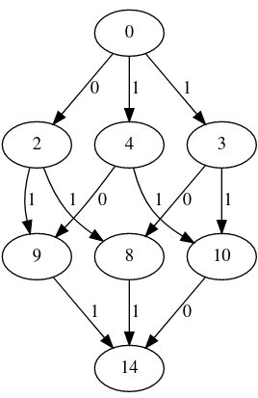
Definitions and Introduction (2)
[1]
Notes:
Optimization options are flags that tell the compiler to perform some type of work. Usually for improving performance or code size, but comes at the cost of compilation time (which can already be hours long), and it makes debugging more difficult
For creating new optimization options and exploring the landscape, there are some difficulties
Gcc has a total number of options near 200. But, permutation and setting matters
Debuggers, linkers, legacy support matters too
Creating the most optimal code or novel techniques break a language’s compliance
Hyperspecific or niche cases won’t get implemented in compiler: expensive and lots of work
Options can make your program worse
Registers, timing (race conditions), debugging, accuracy, caches/memory access, storage, etc

Slide 5
Definitions and Introduction (3)
Analysis Difficulties for DAGs:
    Asymmetric adjacency matrices
    Eigenvector centralities are not applicable [6]
    Graph Laplacian is often undefined [7]
    Complex eigenvalues [7]
    Adjacency matrices are unable to be diagonalized [7]
Notes:
Optimization options are flags that tell the compiler to perform some type of work. Usually for improving performance or code size, but comes at the cost of compilation time (which can already be hours long), and it makes debugging more difficult
For creating new optimization options and exploring the landscape, there are some difficulties
Gcc has a total number of options near 200. But, permutation and setting matters
Debuggers, linkers, legacy support matters too
Creating the most optimal code or novel techniques break a language’s compliance
Hyperspecific or niche cases won’t get implemented in compiler: expensive and lots of work
Options can make your program worse
Registers, timing (race conditions), debugging, accuracy, caches/memory access, storage, etc

Slide 6
Definitions and Introduction (4)
Related Work:
    Centralities for Attack Graphs [8]
      Katz, K-path Edge, PageRank
    Hermitian adjacency matrix [9]
      Avoid complex eigenvalues
    Directed graph spectra [10] combined with Schur’s Theorem [7]
      Bounded eigenvalues and explicit computation
Notes:
Optimization options are flags that tell the compiler to perform some type of work. Usually for improving performance or code size, but comes at the cost of compilation time (which can already be hours long), and it makes debugging more difficult
For creating new optimization options and exploring the landscape, there are some difficulties
Gcc has a total number of options near 200. But, permutation and setting matters
Debuggers, linkers, legacy support matters too
Creating the most optimal code or novel techniques break a language’s compliance
Hyperspecific or niche cases won’t get implemented in compiler: expensive and lots of work
Options can make your program worse
Registers, timing (race conditions), debugging, accuracy, caches/memory access, storage, etc

Slide 7
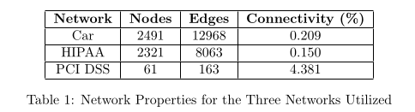
Experimental Networks (1)
Three Networks:
  Vehicle Maintenance Network
  HIPAA Compliance Network
  PCI DSS Network
Notes:
Optimization options are flags that tell the compiler to perform some type of work. Usually for improving performance or code size, but comes at the cost of compilation time (which can already be hours long), and it makes debugging more difficult
For creating new optimization options and exploring the landscape, there are some difficulties
Gcc has a total number of options near 200. But, permutation and setting matters
Debuggers, linkers, legacy support matters too
Creating the most optimal code or novel techniques break a language’s compliance
Hyperspecific or niche cases won’t get implemented in compiler: expensive and lots of work
Options can make your program worse
Registers, timing (race conditions), debugging, accuracy, caches/memory access, storage, etc

Slide 8
Centralities (1)
Degree
  Trivial, localized
  High in-degree centrality: greater probability the system may enter this state
  High out-degree centrality: creates further opportunity for violation
Notes:
Optimization options are flags that tell the compiler to perform some type of work. Usually for improving performance or code size, but comes at the cost of compilation time (which can already be hours long), and it makes debugging more difficult
For creating new optimization options and exploring the landscape, there are some difficulties
Gcc has a total number of options near 200. But, permutation and setting matters
Debuggers, linkers, legacy support matters too
Creating the most optimal code or novel techniques break a language’s compliance
Hyperspecific or niche cases won’t get implemented in compiler: expensive and lots of work
Options can make your program worse
Registers, timing (race conditions), debugging, accuracy, caches/memory access, storage, etc

Slide 9

Centralities (2)
Betweenness
  Importance related to information flow
  Shortest pair between all pairs of nodes in a network
  High betweenness centrality: quickest way that systems may fall out of compliance
[1]
Notes:
Optimization options are flags that tell the compiler to perform some type of work. Usually for improving performance or code size, but comes at the cost of compilation time (which can already be hours long), and it makes debugging more difficult
For creating new optimization options and exploring the landscape, there are some difficulties
Gcc has a total number of options near 200. But, permutation and setting matters
Debuggers, linkers, legacy support matters too
Creating the most optimal code or novel techniques break a language’s compliance
Hyperspecific or niche cases won’t get implemented in compiler: expensive and lots of work
Options can make your program worse
Registers, timing (race conditions), debugging, accuracy, caches/memory access, storage, etc

Slide 10
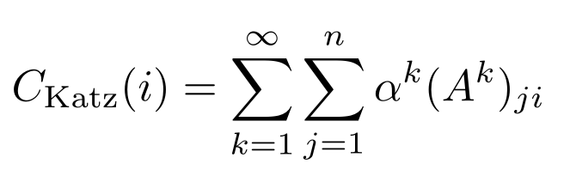

Centralities (3)
Katz [14]
  Importance related to all paths in a network
  High Katz centrality: prevent opportunity of future compliance violation that is reachable, but may be many steps ahead
Notes:
Optimization options are flags that tell the compiler to perform some type of work. Usually for improving performance or code size, but comes at the cost of compilation time (which can already be hours long), and it makes debugging more difficult
For creating new optimization options and exploring the landscape, there are some difficulties
Gcc has a total number of options near 200. But, permutation and setting matters
Debuggers, linkers, legacy support matters too
Creating the most optimal code or novel techniques break a language’s compliance
Hyperspecific or niche cases won’t get implemented in compiler: expensive and lots of work
Options can make your program worse
Registers, timing (race conditions), debugging, accuracy, caches/memory access, storage, etc

Slide 11
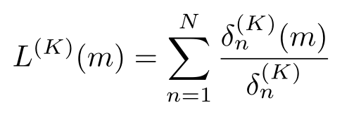
Centralities (4)
K-path Edge [15]
  Importance is related to information flow, but is localized and constrained to k-steps from a given node
  High K-path Edge centrality: identifies a short chain of changes that may result in violation
    Prevent states where the system is near a violation
Notes:
Objectives we’ll go over

Slide 12
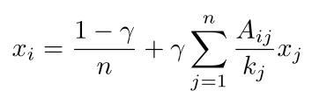

Centralities (5)
PageRank [16], [17]
  Importance related to number and quality of connections
  High PageRank centrality: determine nodes that are likely to be visited, and apply correction schemes near these nodes
Notes:
Objectives we’ll go over

Slide 13
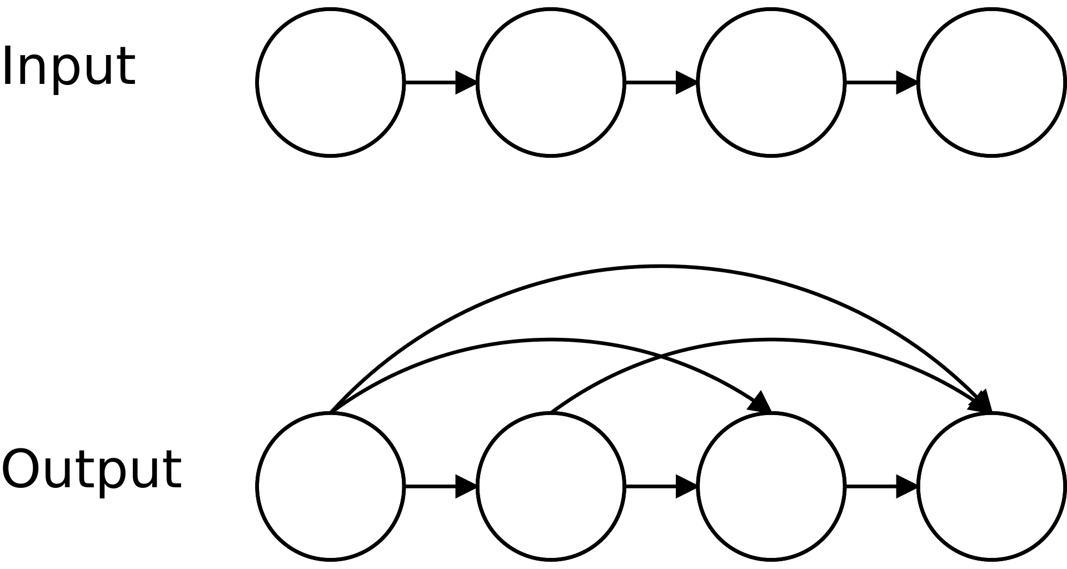
Transitive Closure (1)
Transitive relation on a given binary set
Determine reachability of a given network
Adversarial actions with unlimited time and resources
No prior knowledge of the network, and all changes are equally likely
Notes:
Objectives we’ll go over

Slide 14
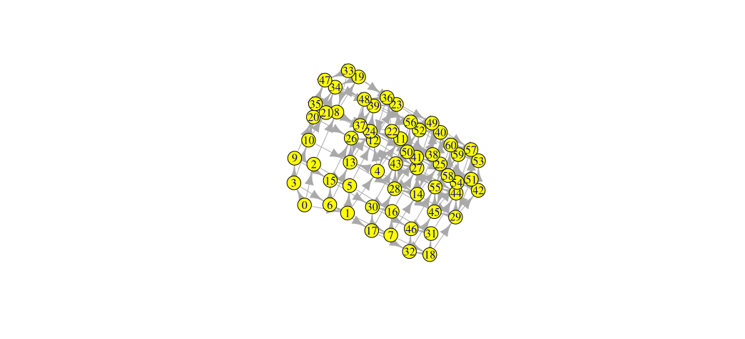
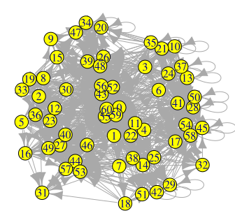
Transitive Closure (2)
Notes:
Objectives we’ll go over

Slide 15
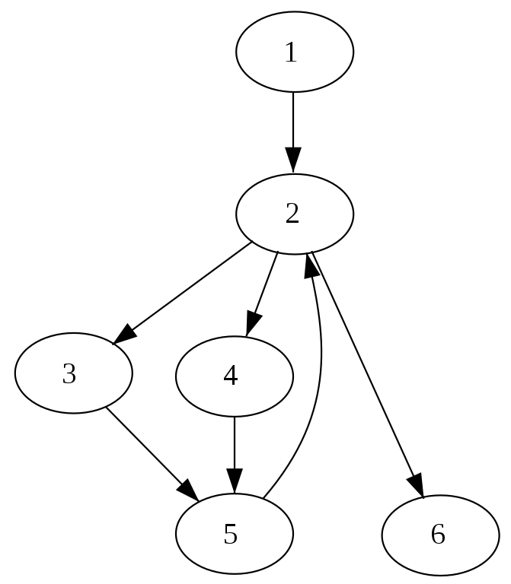
Dominator Tree (1)
Dominance [20]
  Node that is in every path to another node
  Node 2 dominates 2, 3, 4, 5, and 6
Notes:
Objectives we’ll go over

Slide 16
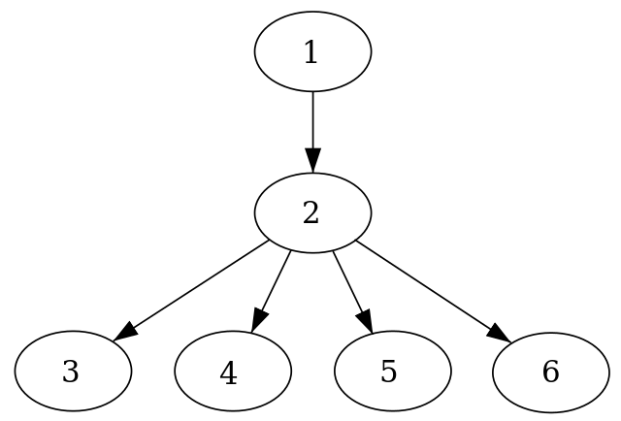
Dominator Tree (2)
Dominator Tree
  Parent nodes immediately dominate its children
  Restructure compliance graphs in terms of information flow
Notes:
Objectives we’ll go over

Slide 17
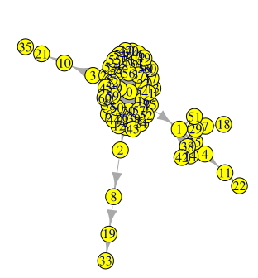
Dominator Tree (3)
Notes:
Objectives we’ll go over

Slide 18
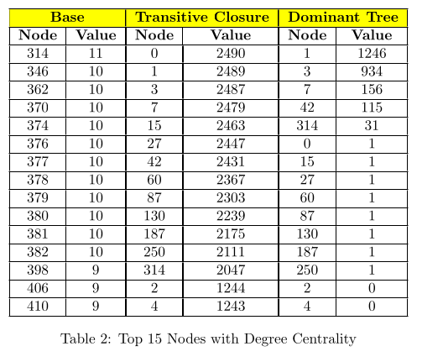
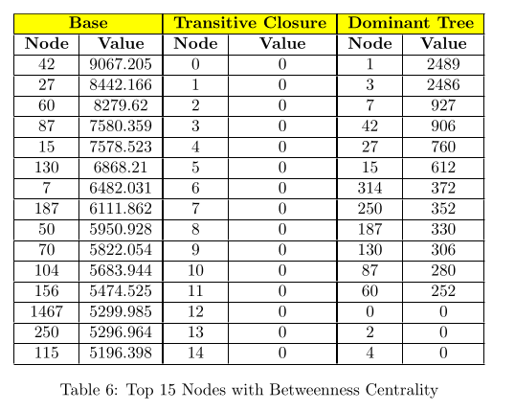
Results (1)
Notes:
Objectives we’ll go over

Slide 19
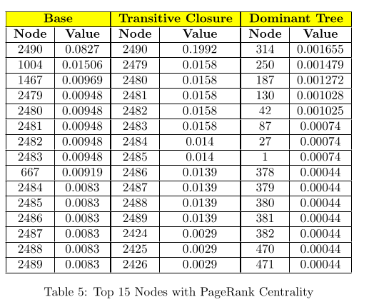
Results (2)
Notes:
Objectives we’ll go over

Slide 20
Conclusions
Each centrality measure provides various information regarding network correction schemes
Unique rankings can be identified from transitive closures and dominator trees
Notes:
Objectives we’ll go over

Slide 21
Future Work
Artificially implement correction schemes based on centrality measures to observe the effects
Implement user-defined data matrices for Katz or PageRank
Edge weights in terms of probability of change
Further research into transitive closures and dominator trees for compliance graph representations
Clustering investigation with methods applicable to DAGs
Notes:
Objectives we’ll go over

Slide 22
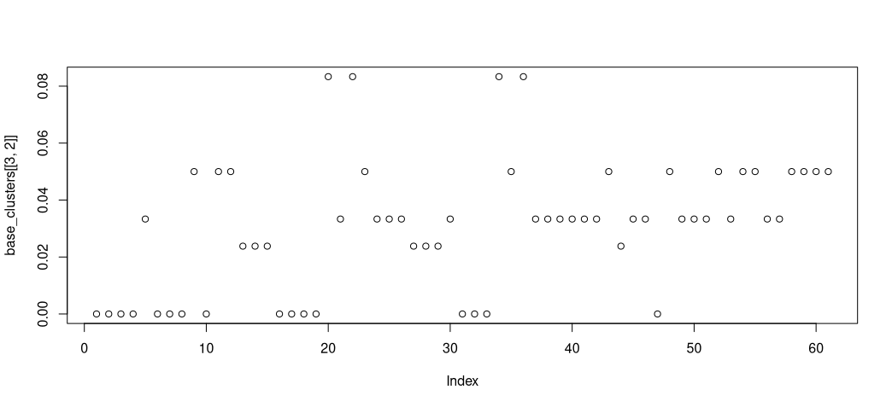
Clemente and Grassi
Notes:
Objectives we’ll go over

Slide 23
Q&A
Notes:
Objectives we’ll go over

