Slide 1
:
Compliance Graph Generation Techniques and
Parallel Computing Implementations Using
Message-Passing Interface
by
Noah L. Schrick
Advised by
Dr. Peter J. Hawrylak

Slide 2
Agenda
Introduction
Objectives
Related Work
Utility Extensions
Synchronous Firing
Parallelization Using Message Passing Interface
Conclusions and Future Work

Slide 3
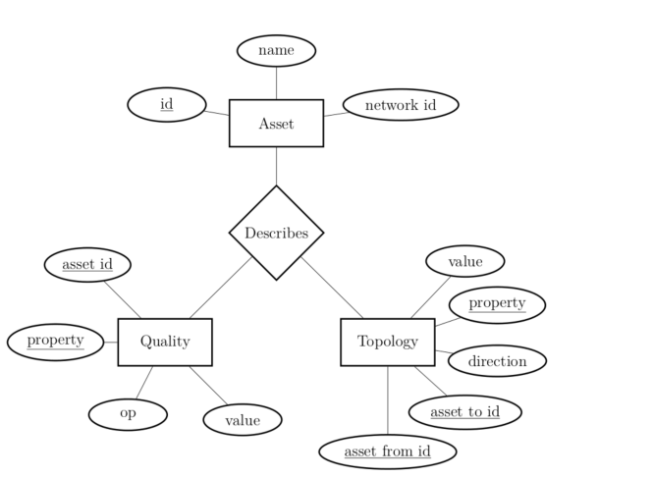
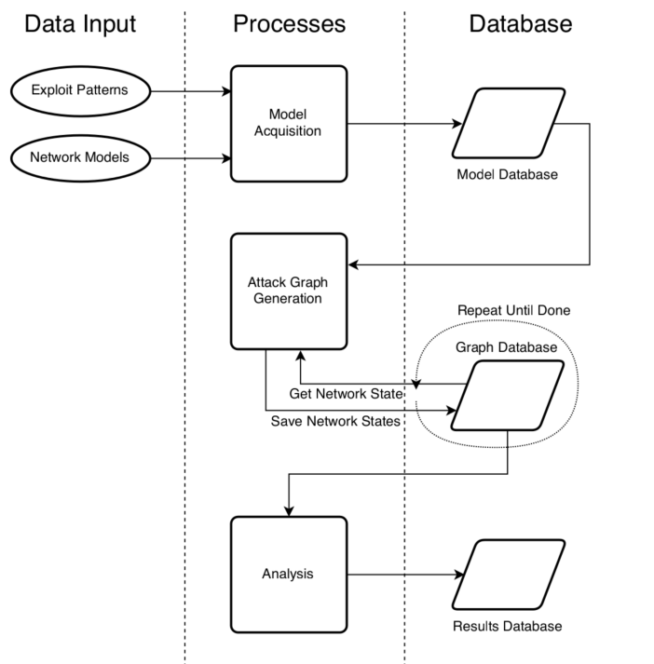
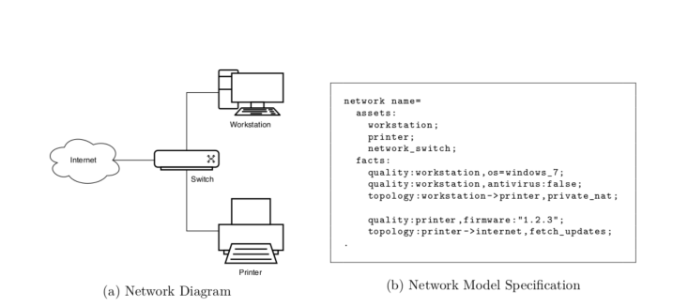
Introduction- Attack Graphs
Network Model Relationship Diagram
[1]
Attack Graph Engine Data Flow Diagram

Slide 4
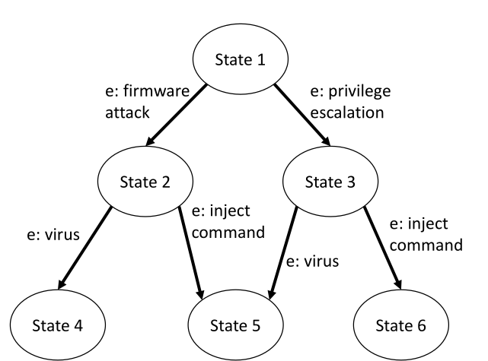
Introduction – Example Attack Graph
[25]

Slide 5
Introduction- Compliance Graphs

Slide 6
Objectives (1/2)
Extend the utility of RAGE to:
  Reduce complexity of network model and exploit file creation
  Expand the complexity of attack modeling
  Allow for the creation of very large sized graphs, assuming very large storage
  Split graphs into subgraphs to simplify analysis of individual states

Slide 7
Objectives (2/2)
Implement a synchronous firing solution to reduce state space explosion for inseparable features while remaining exhaustive and capturing all necessary information
Extend RAGE to function for distributed computing environment
Extend RAGE to support compliance graph generation

Slide 8
Related Work – Graph Generation Improvements
Explicit tuning of the hardware prefetcher [15]
Pipeline parallelization of atomic functions [16]
Leveraging FPGAs in the HPC space [5], [17]
Distributed adjacency lists [20]
High compression ratios and low compression cost to minimize communication cost [20], [21]
Boost Graph Library and Parallel Boost Graph Library [22], [23]

Slide 9
Related Work– Attack Graph Generation Improvements
Logical attack graphs [3]
RAGE [24]
RAGE improvements [25]
Distributed algorithm using virtual shared memory [27]

Slide 10
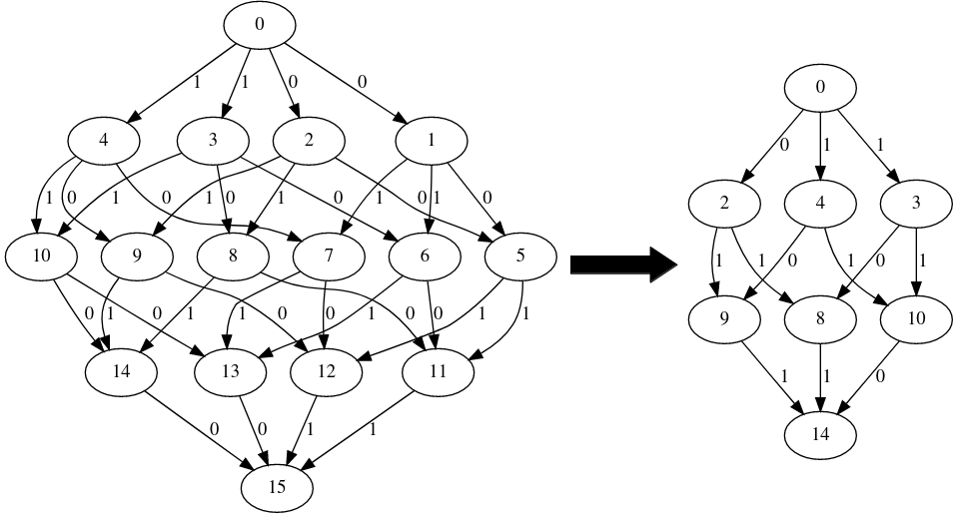
Utility Extensions: Path Walking
Output a subset of the graph: all possible paths from root to a designated state
Focus only on specific states without needing to analyze the entirety of the graph.
Path Walking to State 14:
16 States → 6 States
32 Edges → 12 edges

Slide 11
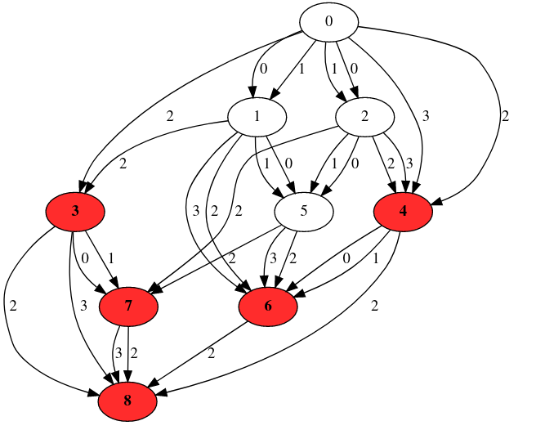
Utility Extensions: Path Walking
Visual differentiation of problematic states based on severity

Slide 12
Utility Extensions: Compound Operators

Slide 13
Utility Extensions: Relational Operators

Slide 14
Utility Extensions: Intermediate Database Storage

Slide 15
Synchronous Firing: Related Work

Slide 16
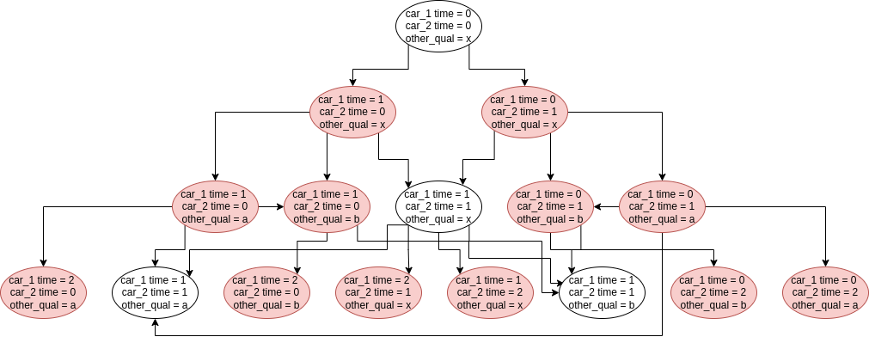
Synchronous Firing: Introduction

Slide 17
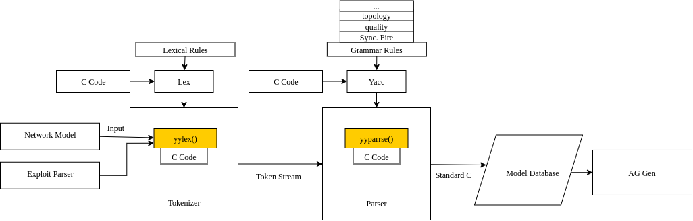
Synchronous Firing: Alterations and Additions (1/3)

Slide 18
Synchronous Firing: Alterations and Additions (2/3)

Slide 19
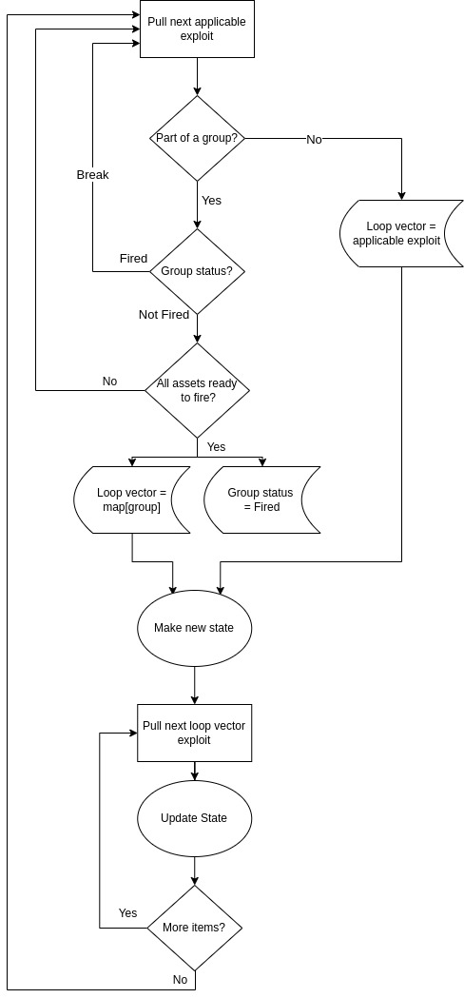
Synchronous Firing: Alterations and Additions (3/3)

Slide 20
Synchronous Firing: Experimental Networks

Slide 21
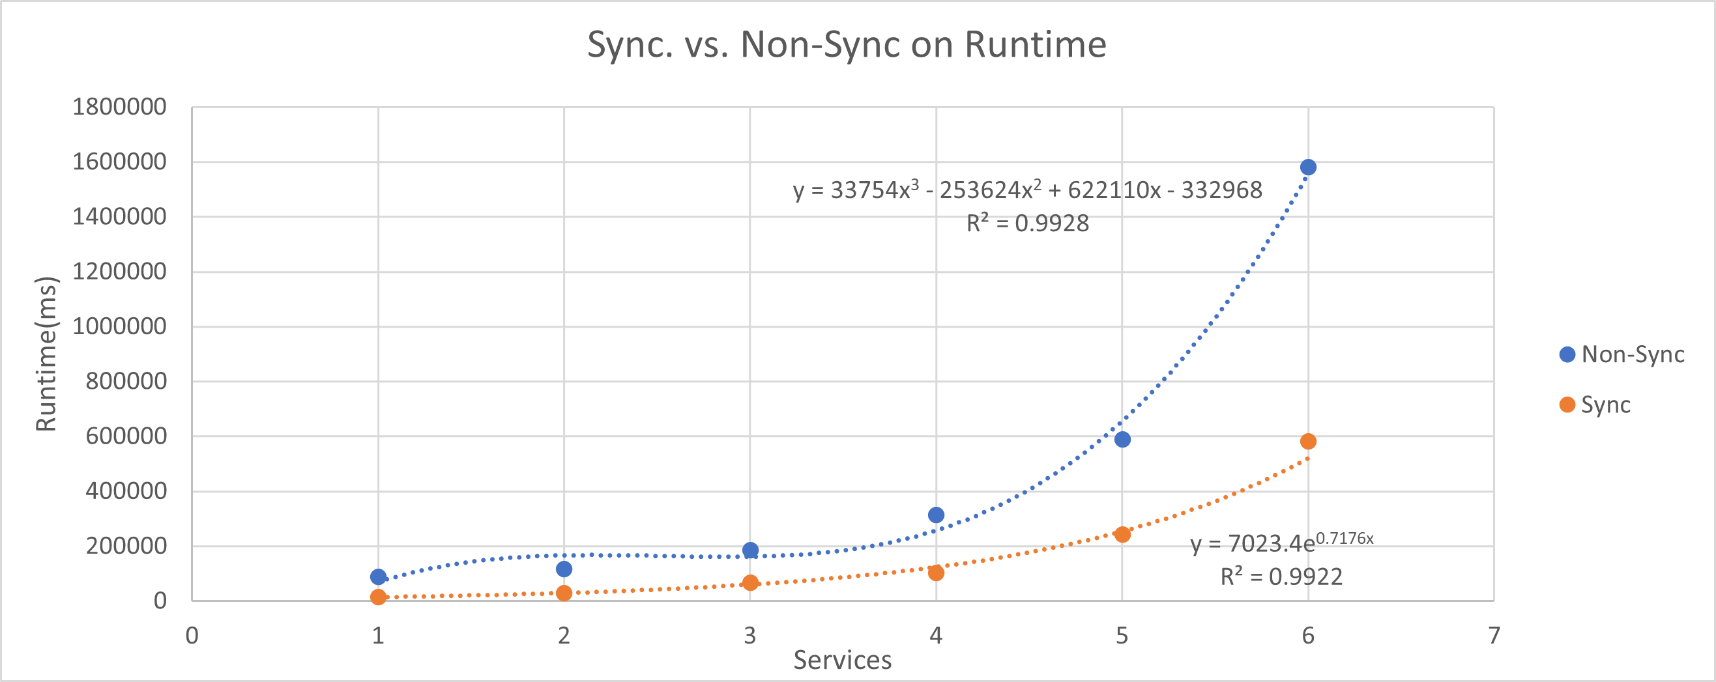
Synchronous Firing: Results - Runtime

Slide 22
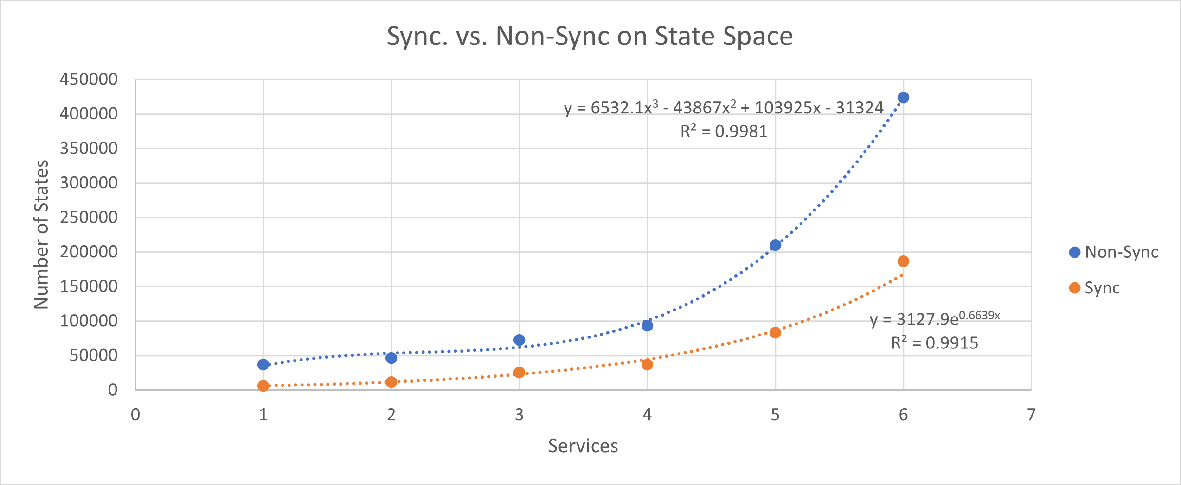
Synchronous Firing: Results – State Space

Slide 23
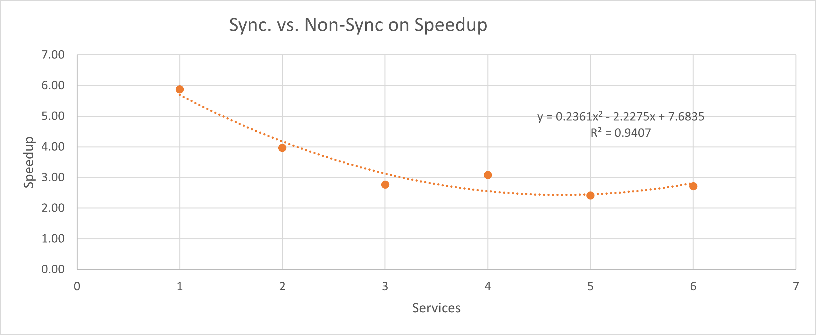
Synchronous Firing: Results – Synchronous Speedup

Slide 24
MPI Parallelization: Introduction

Slide 25
MPI Parallelization: Serialization

Slide 26
MPI Parallelization: Tasking Approach Intro

Slide 27
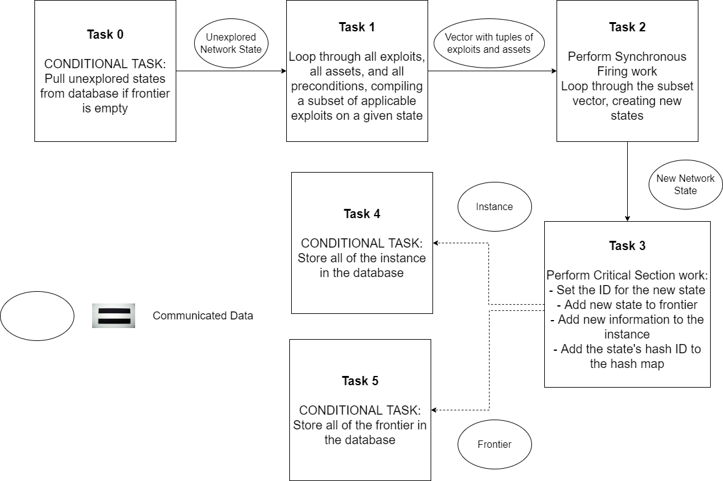
MPI Parallelization: Tasking Approach- Design (1/2)

Slide 28
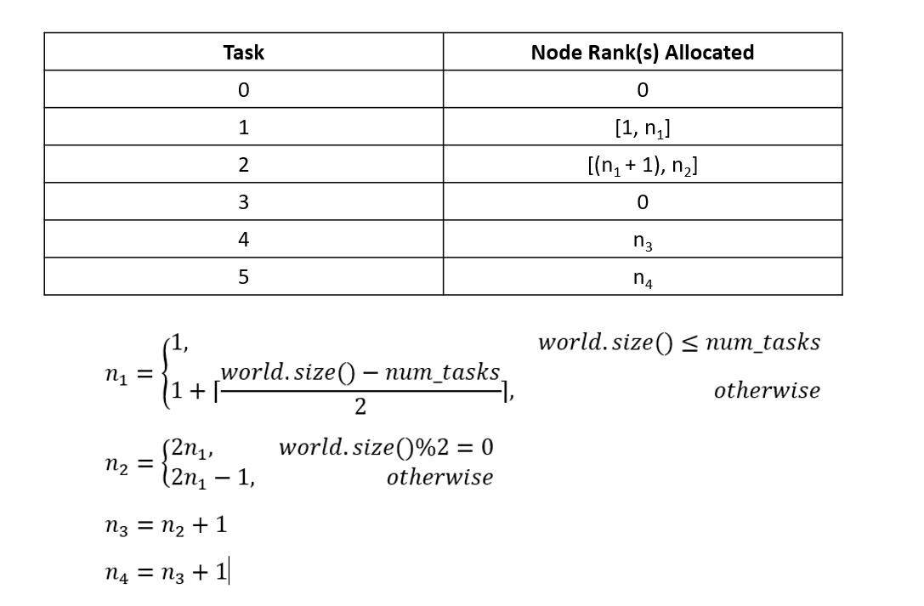
MPI Parallelization: Tasking Approach- Design (2/2)

Slide 29
MPI Parallelization: Tasking Approach- Task 0

Slide 30
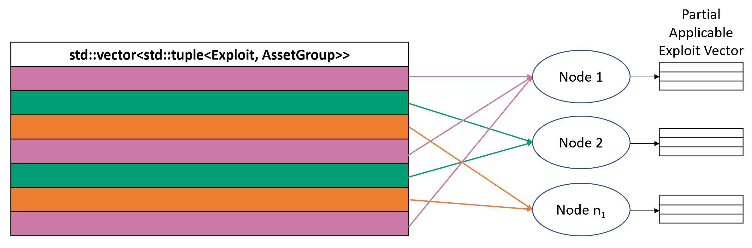
MPI Parallelization: Tasking Approach- Task 1

Slide 31
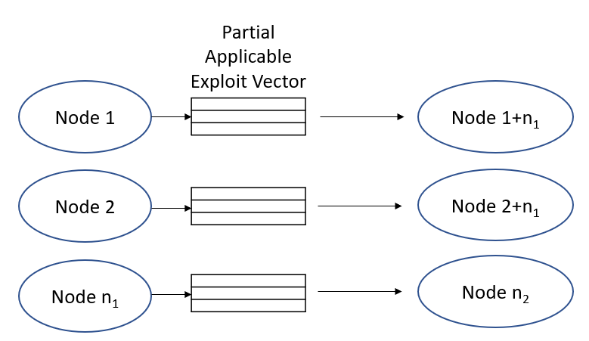
MPI Parallelization: Tasking Approach- Task 2, Case 1

Slide 32
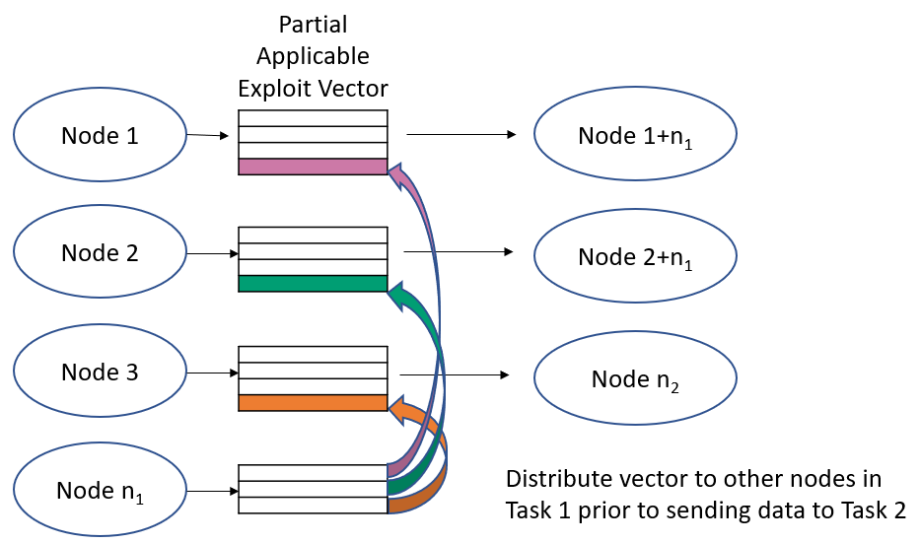
MPI Parallelization: Tasking Approach- Task 2, Case 2

Slide 33
MPI Parallelization: Tasking Approach- Task 3

Slide 34
MPI Parallelization: Tasking Approach- Task 4 and 5

Slide 35
MPI Parallelization: Tasking Approach- Tags

Slide 36
MPI Parallelization: Tasking Approach- Expectations

Slide 37
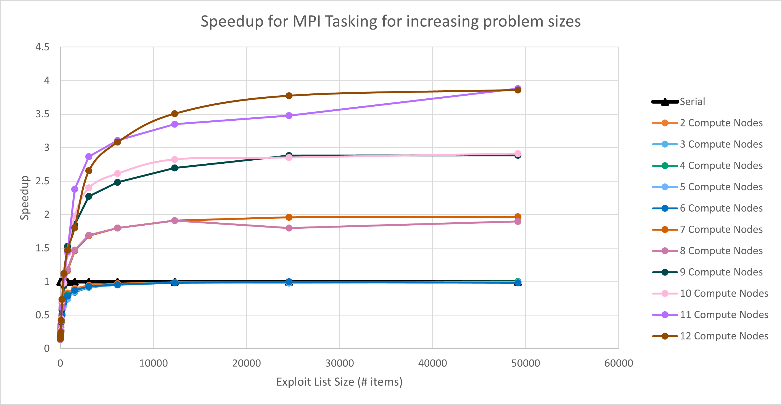
MPI Parallelization: Tasking Approach- Results, Speedup

Slide 38
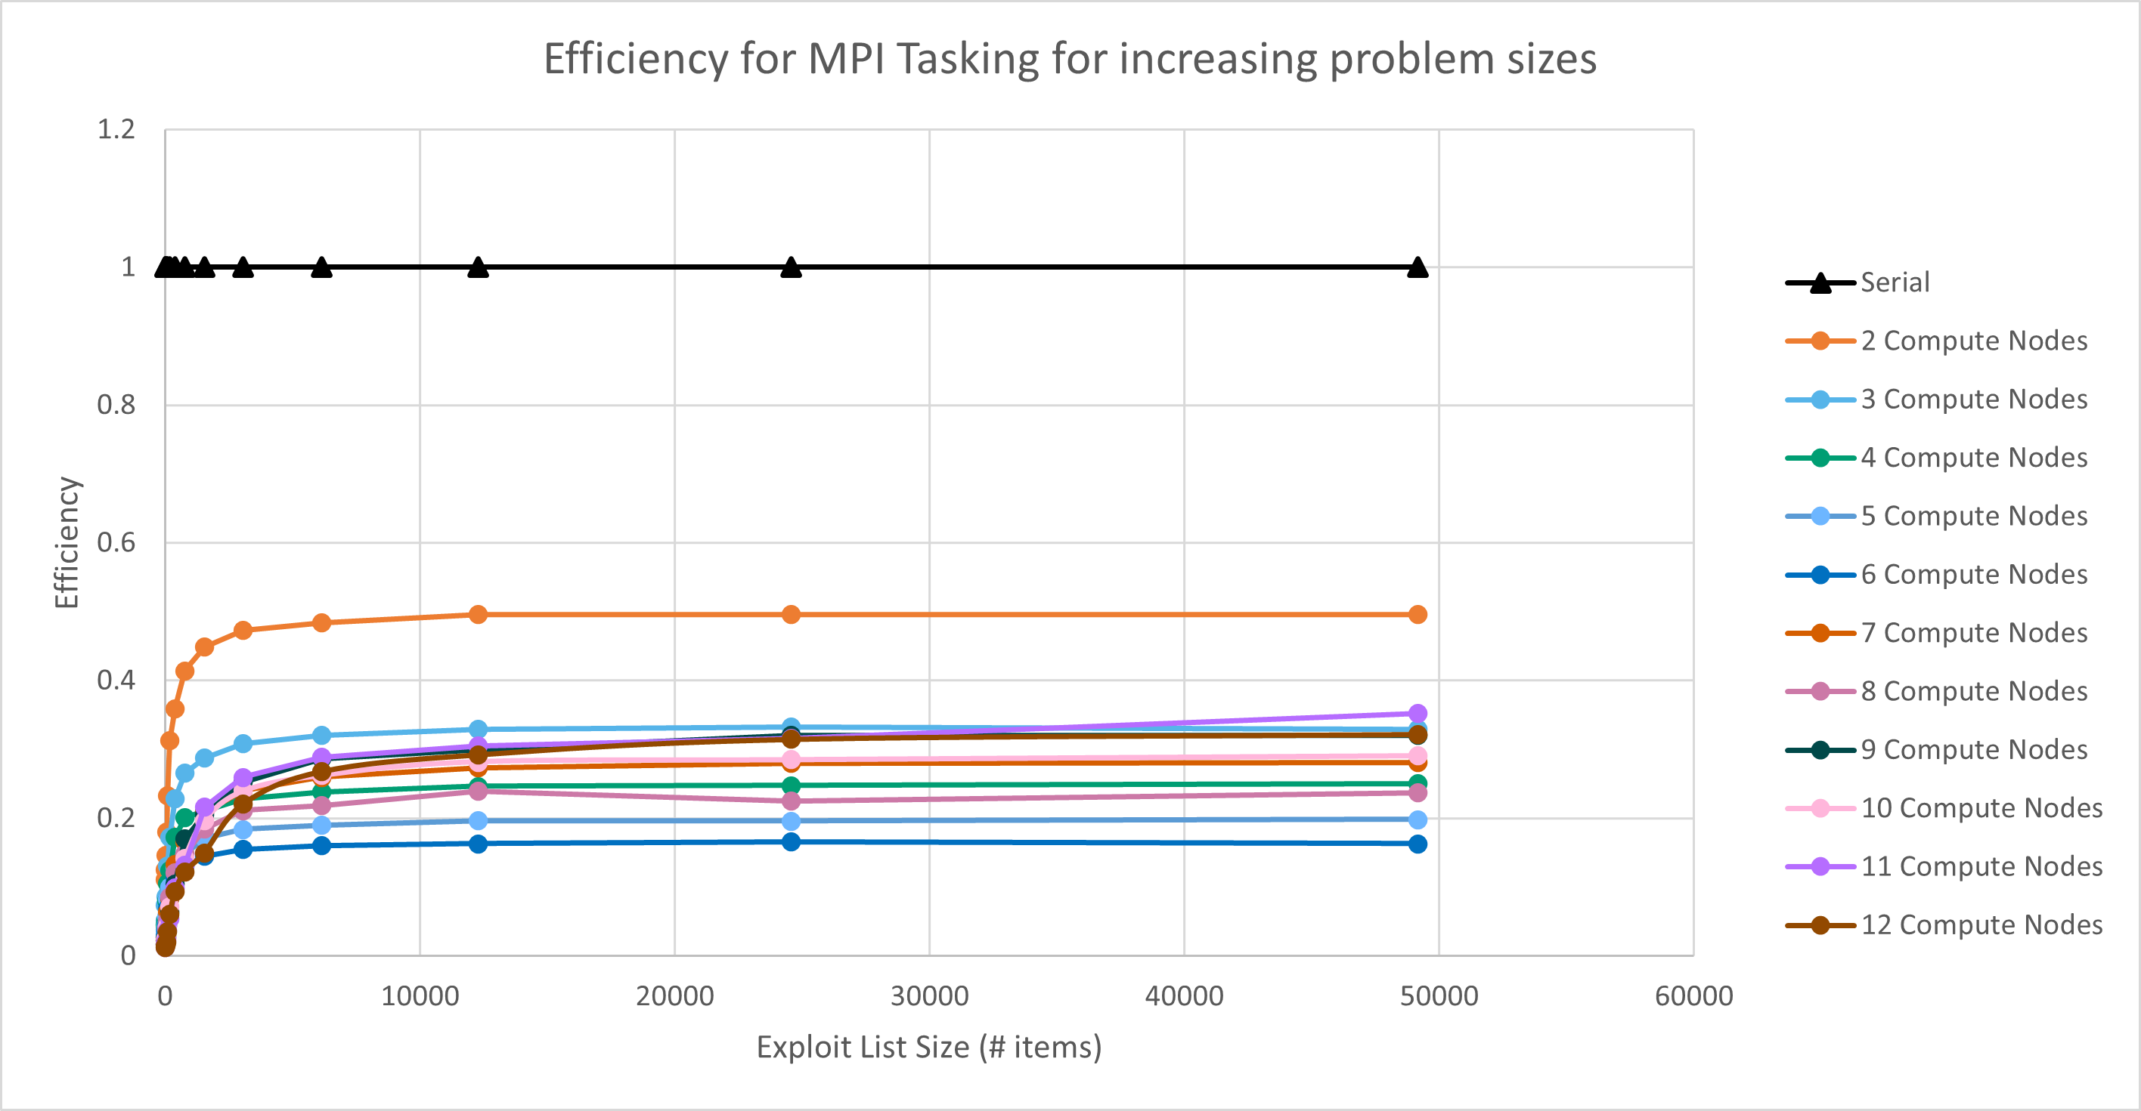
MPI Parallelization: Tasking Approach- Results, Efficiency

Slide 39
MPI Parallelization: Subgraphing Approach- Intro

Slide 40
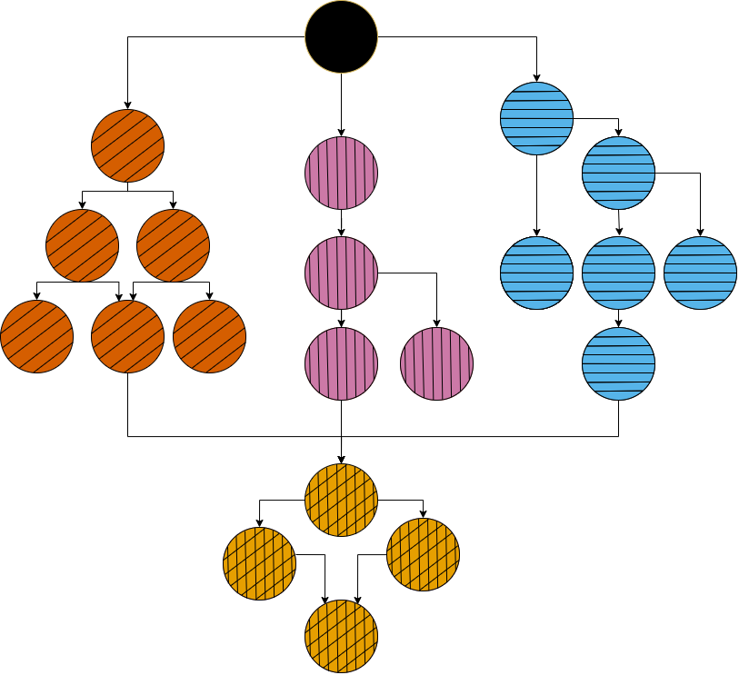
MPI Parallelization: Subgraphing Approach- Design

Slide 41
MPI Parallelization: Subgraphing Approach- Workers

Slide 42
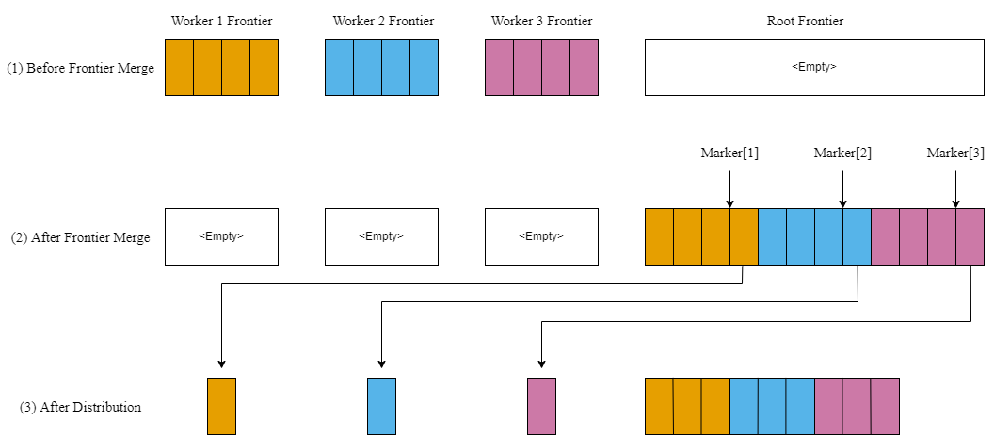
MPI Parallelization: Subgraphing Approach- Root

Slide 43
MPI Parallelization: Subgraphing Approach- Database

Slide 44
MPI Parallelization: Subgraphing Approach- Tags

Slide 45
MPI Parallelization: Subgraphing Approach- Expectations

Slide 46
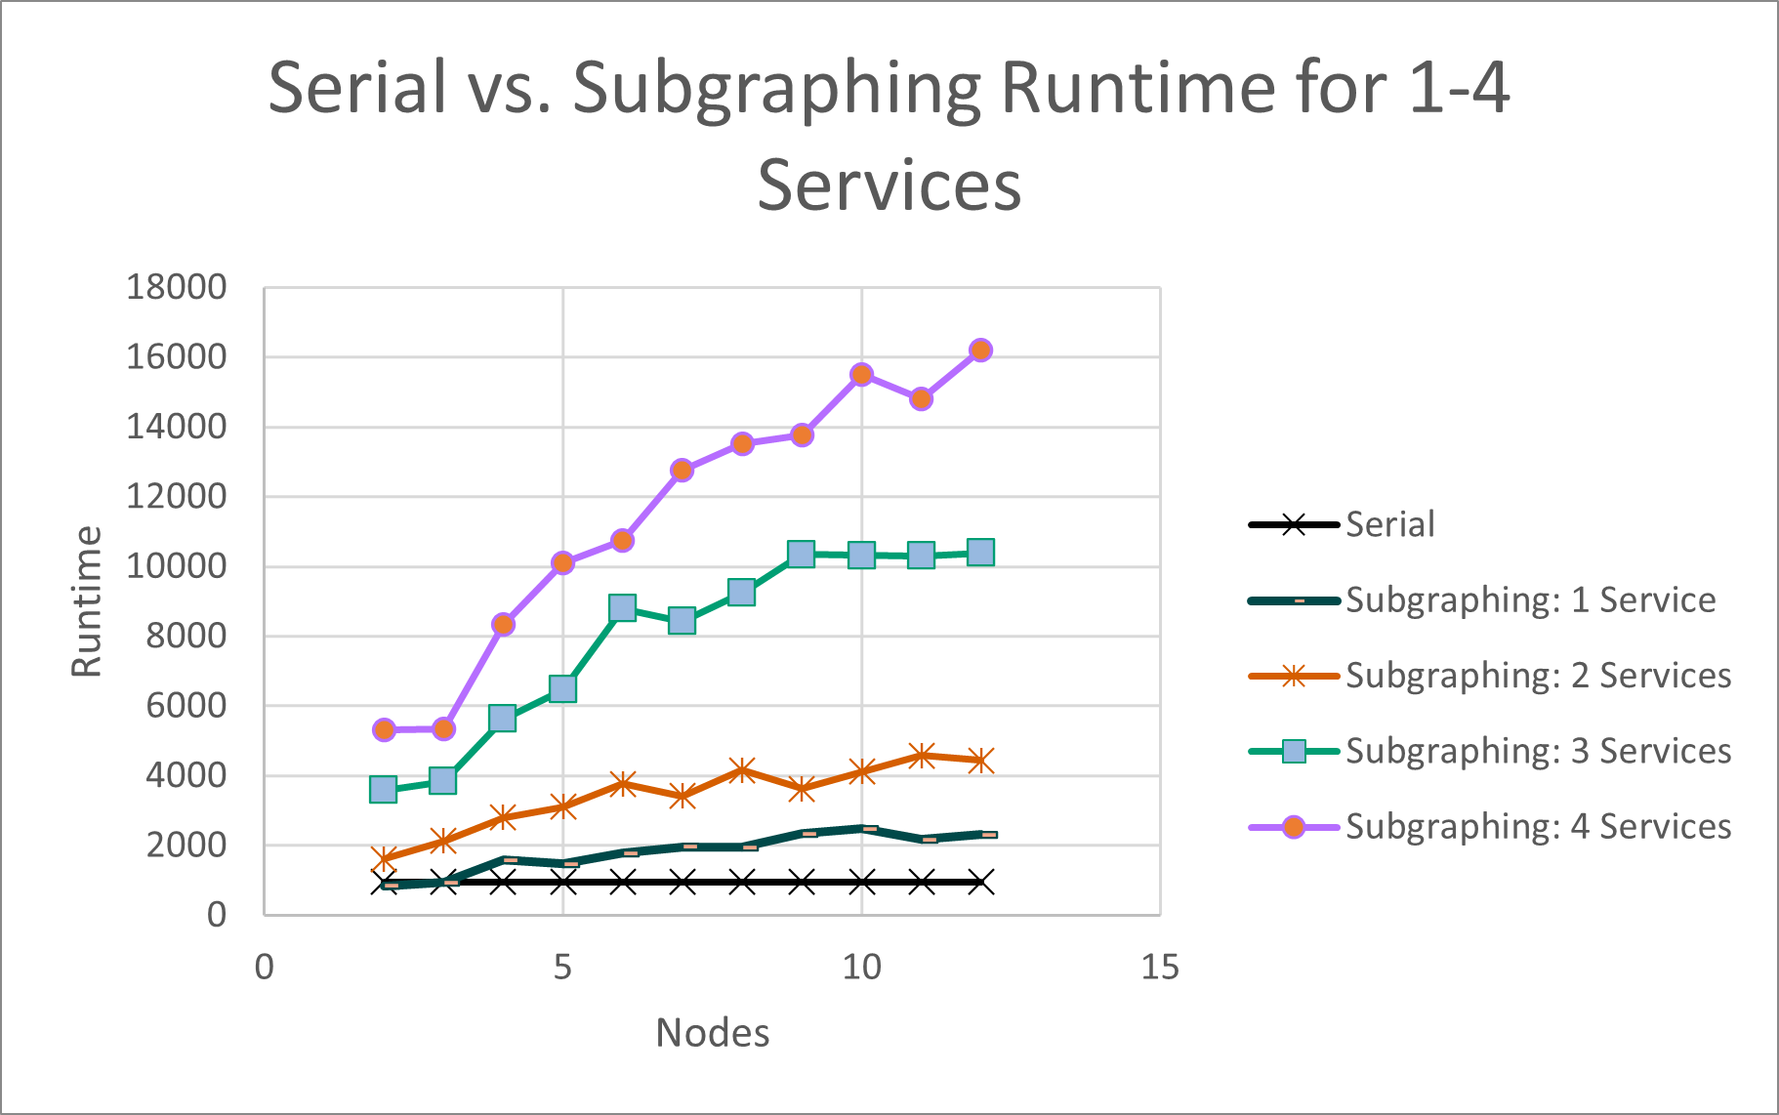
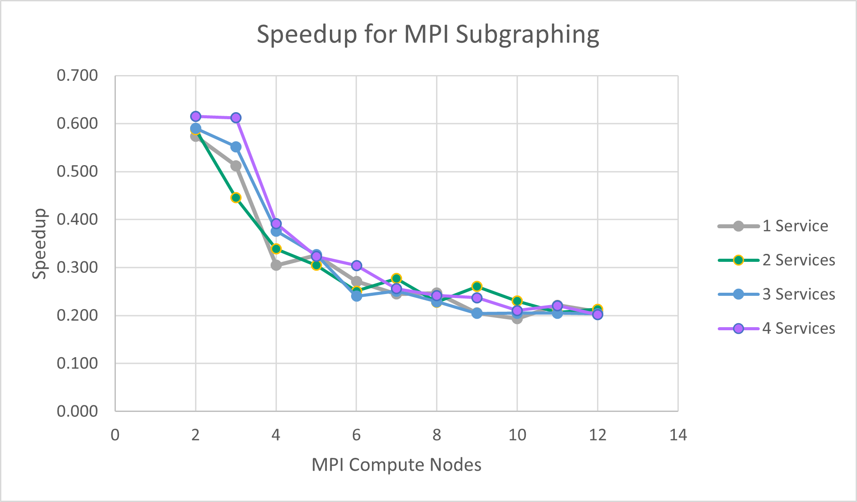
MPI Parallelization: Subgraphing Approach- Results

Slide 47
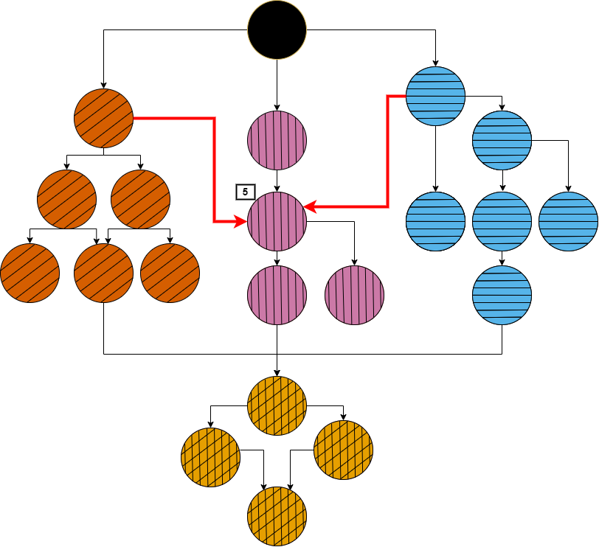

Slide 48
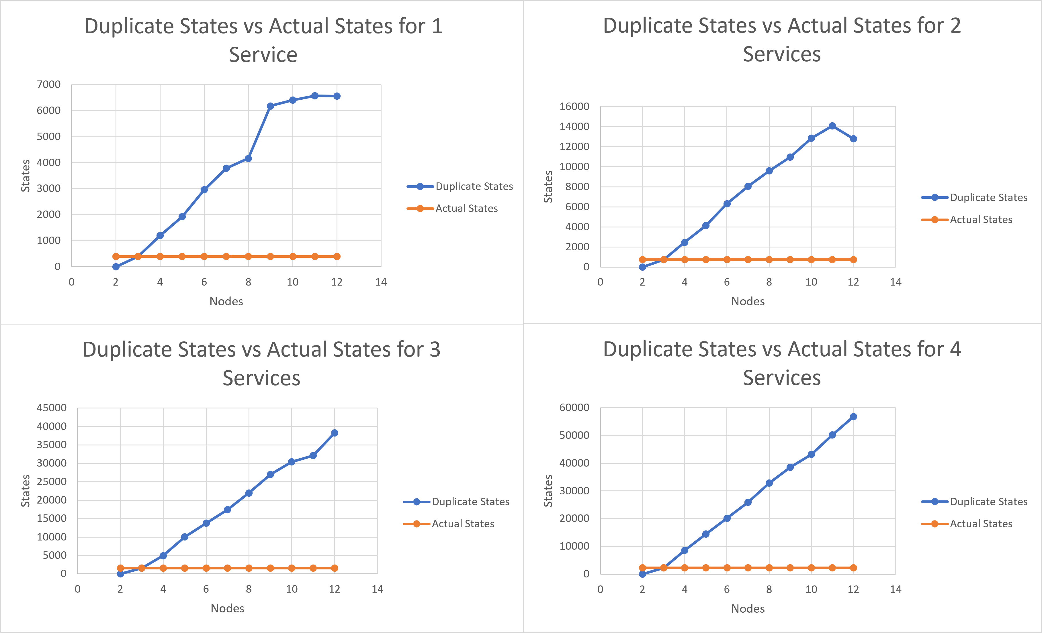
MPI Parallelization: Subgraphing Approach- Challenges

Slide 49
MPI Parallelization: Subgraphing Approach- DHT

Slide 50
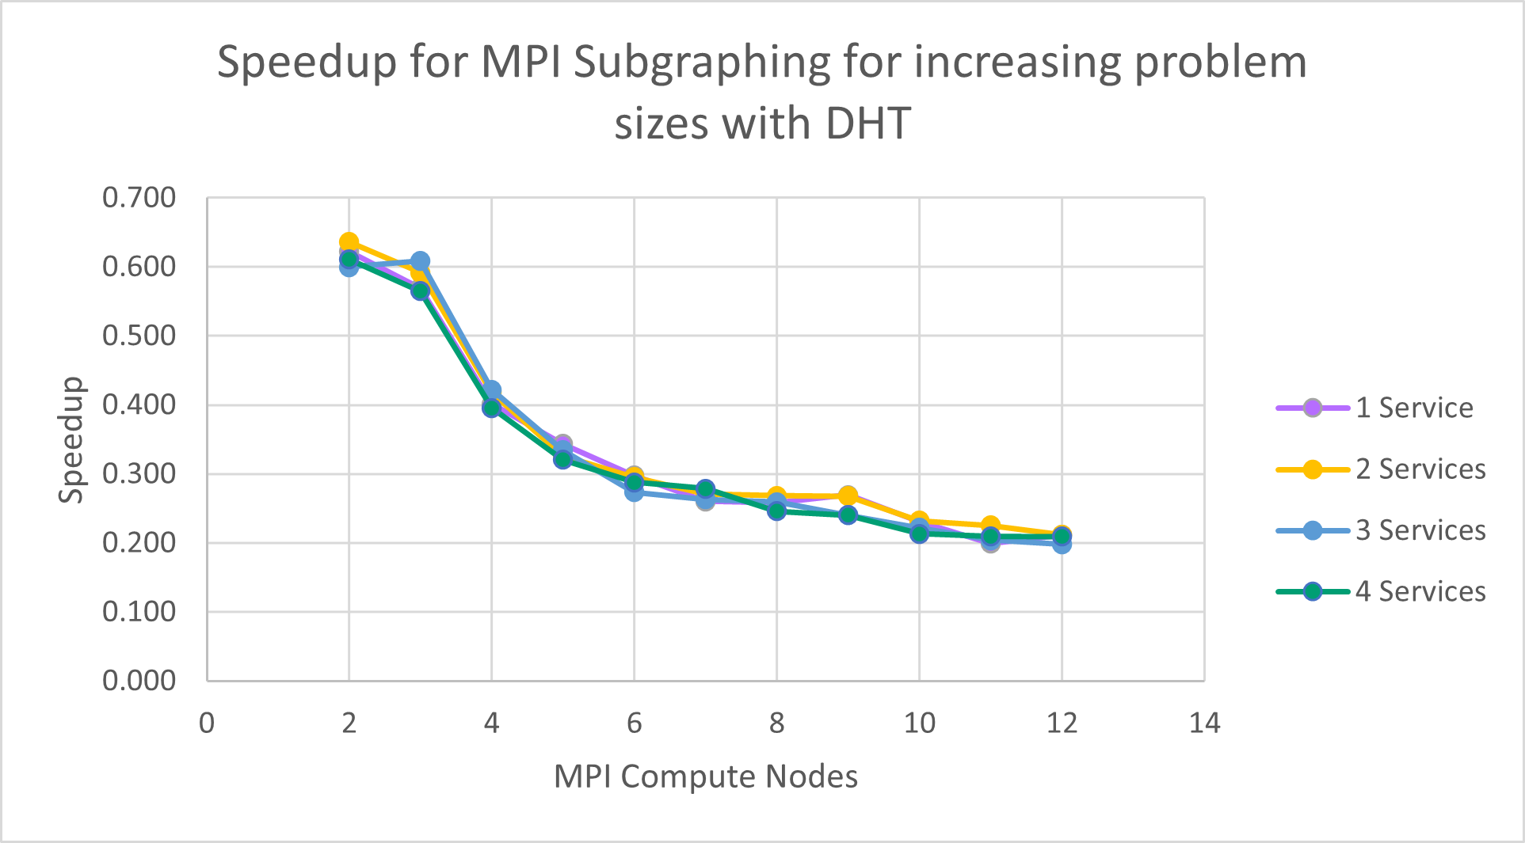
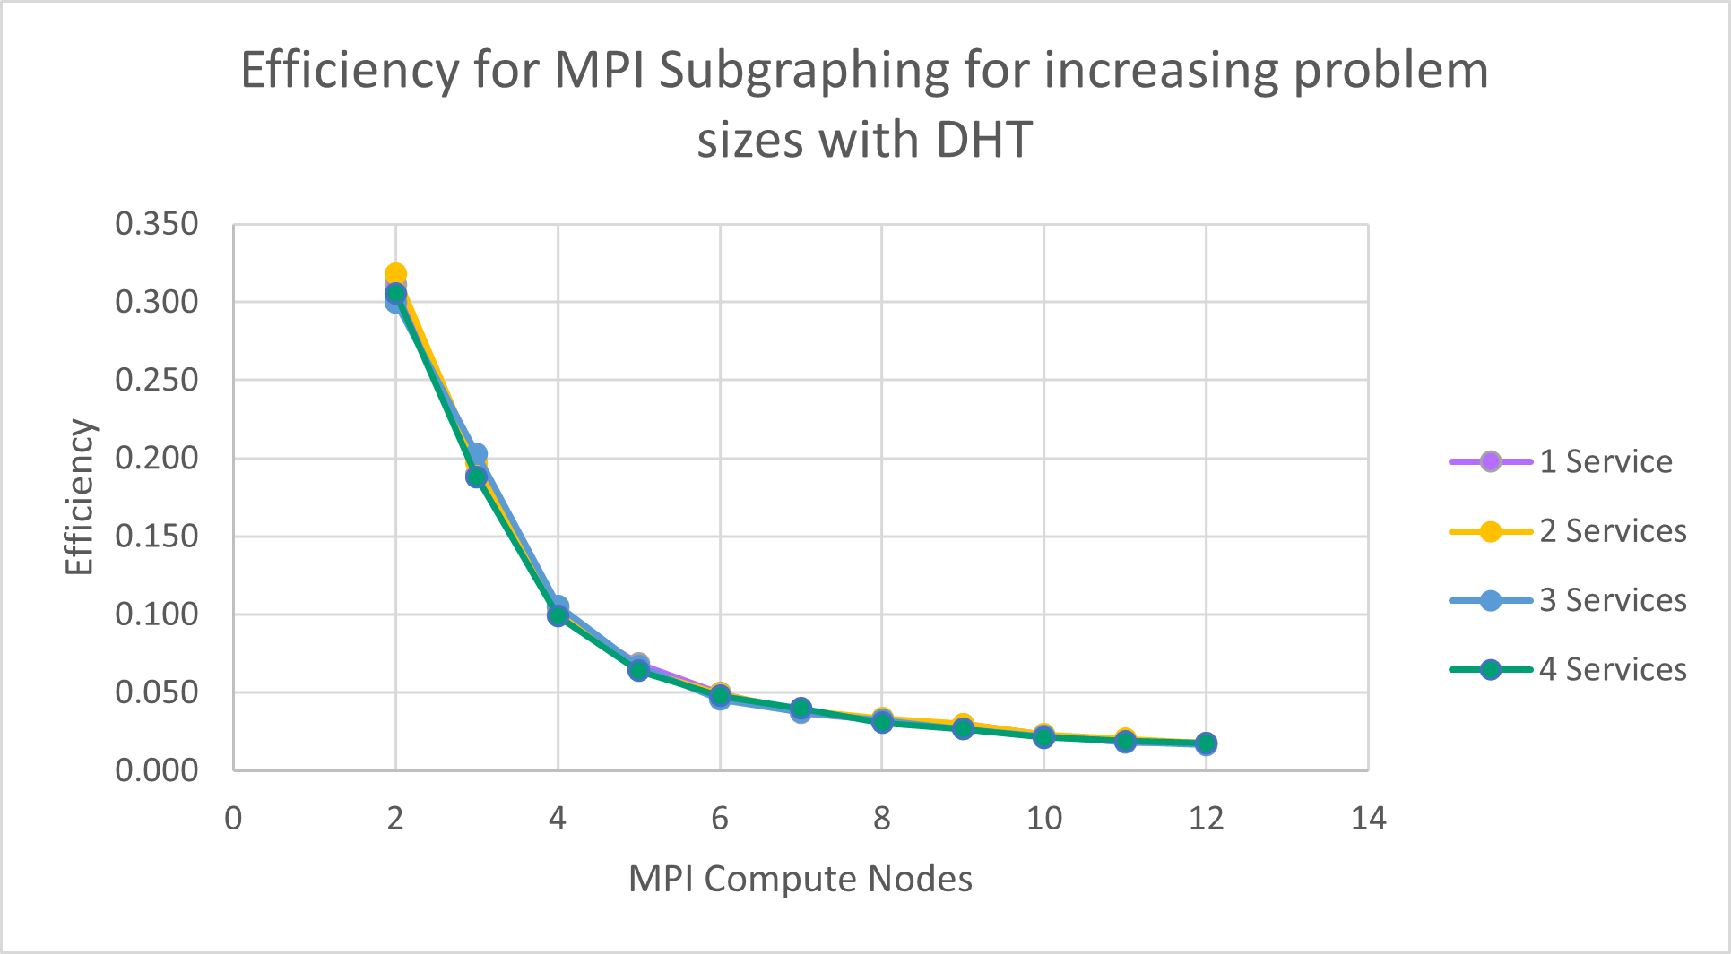
MPI Parallelization: Subgraphing Approach- DHT Results

Slide 51
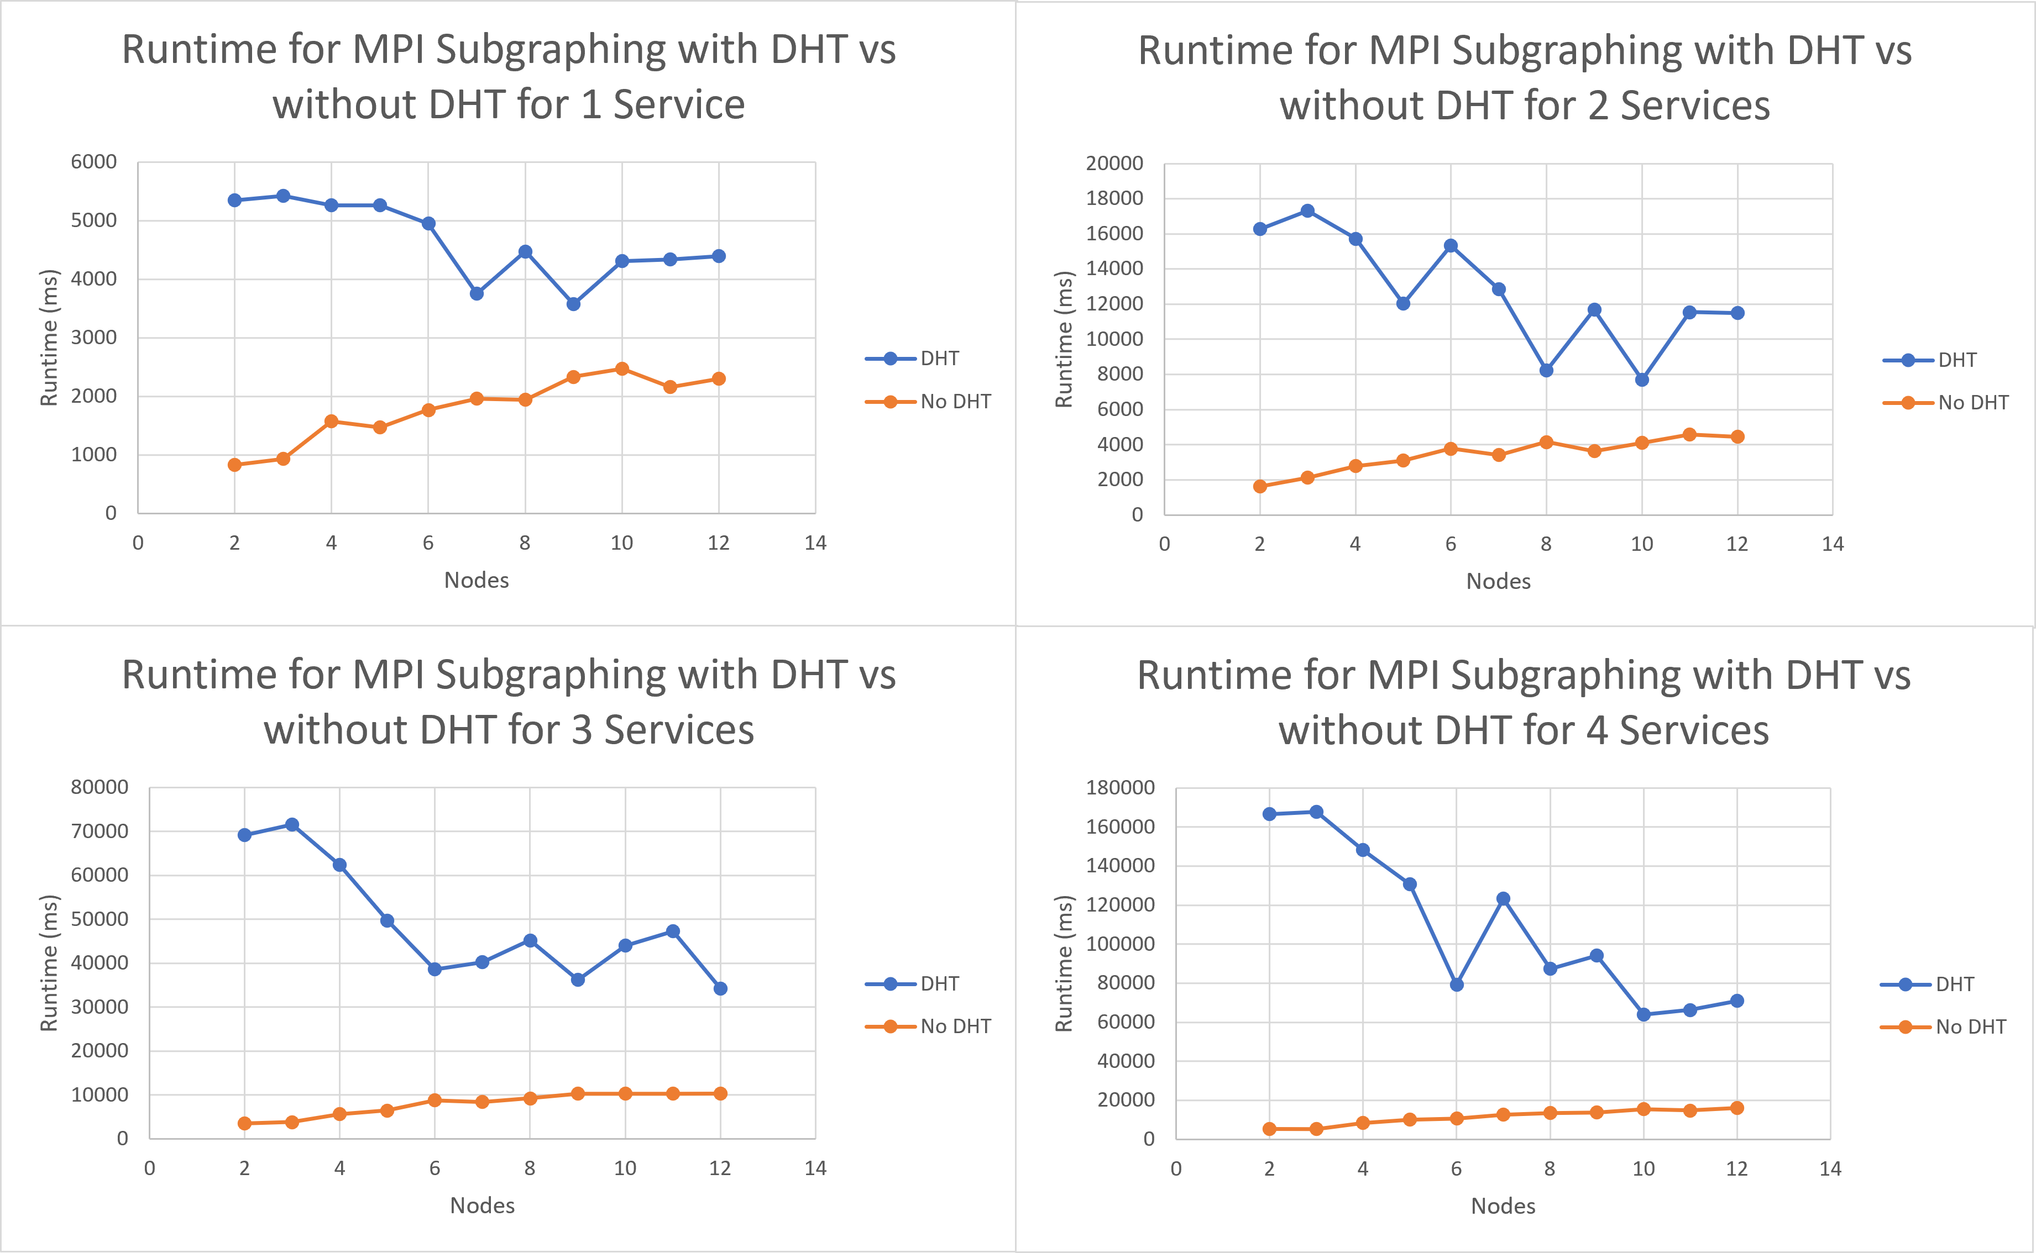
MPI Parallelization: Subgraphing Approach- DHT vs no DHT Results

Slide 52
Conclusions

Slide 53
Future Work (1/2)
Synchronous Firing with more assets in a group
Blending OpenMP and MPI for the MPI Tasking Approach
Effectiveness of MPI Tasking with many applicable exploits at any given state
Alternate methods for an effective MPI Subgraphing Approach
MPI Parameter Tunings
MPI Implementation Testing

Slide 54
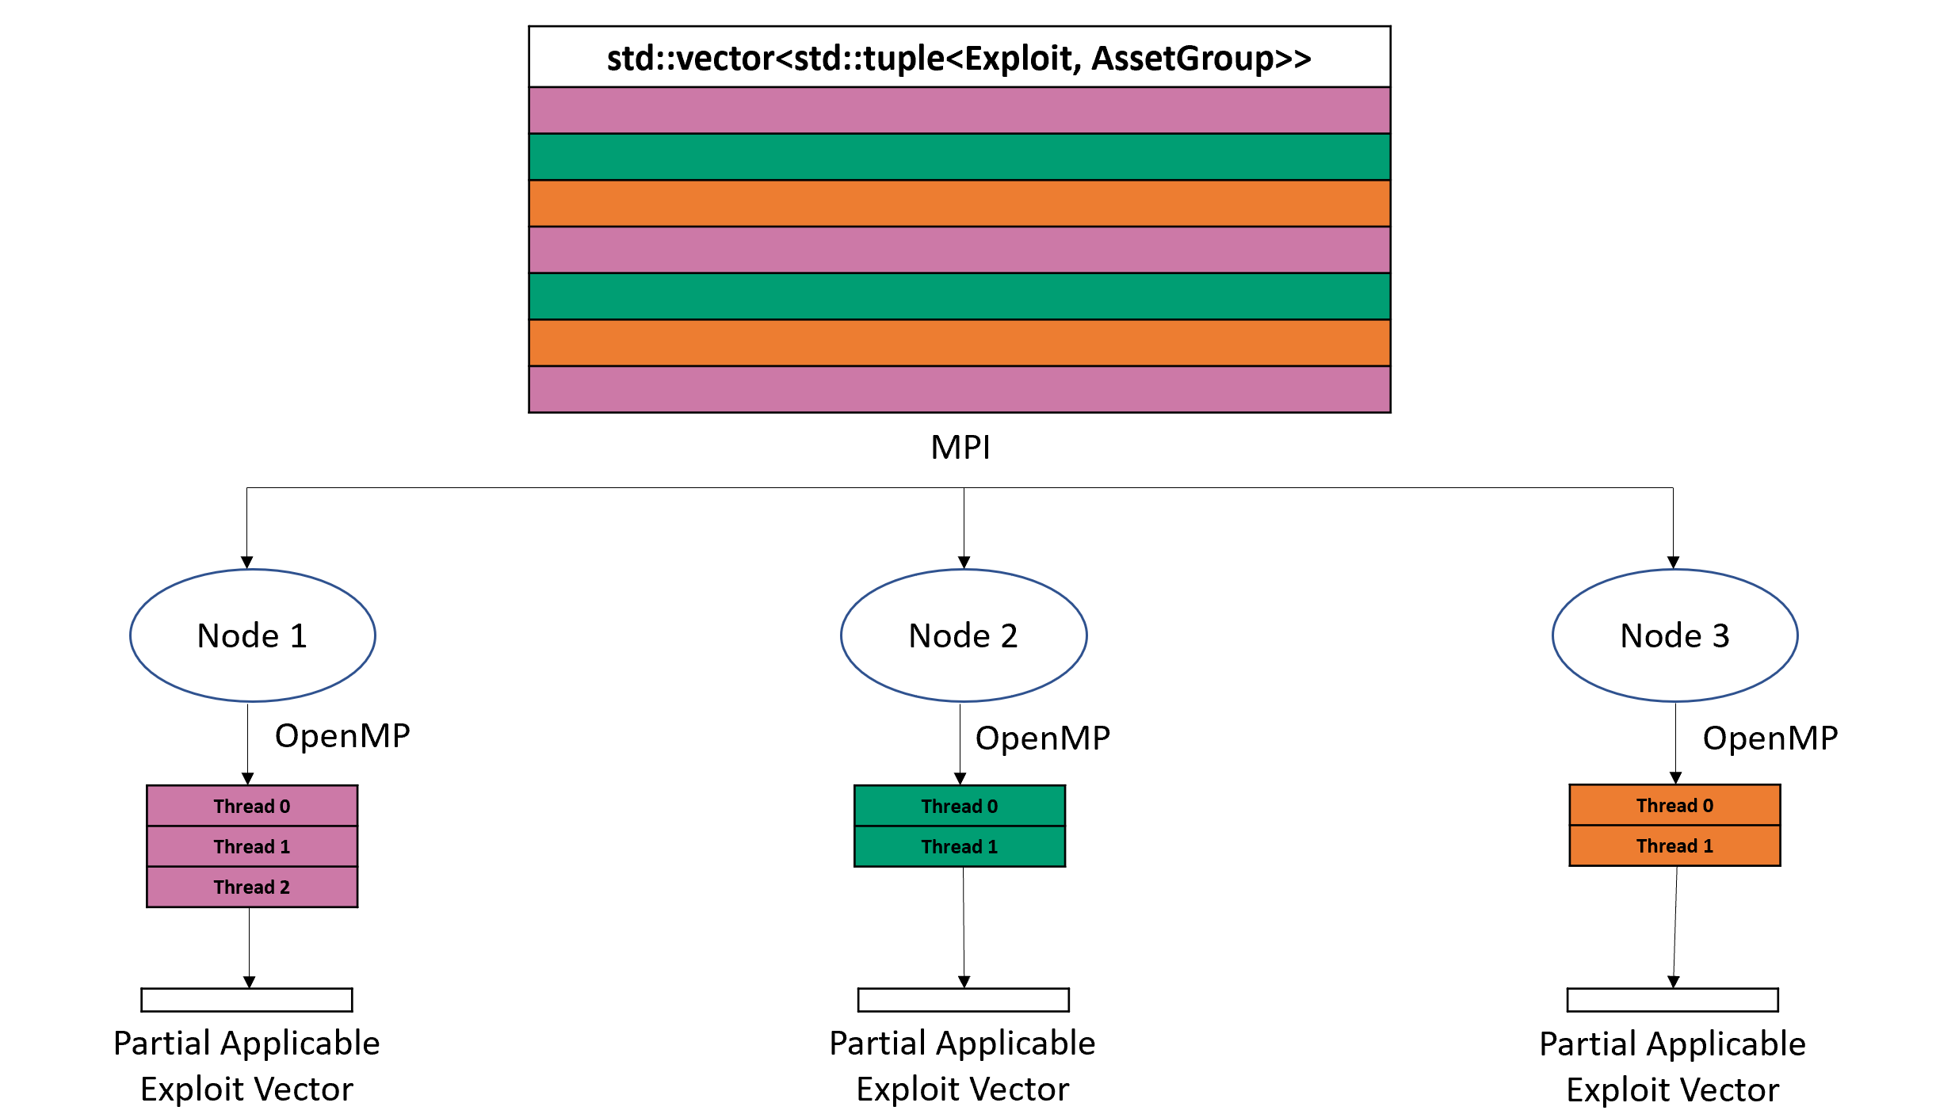
Future Work (2/2)

Slide 55
Objective Recap (1/2)
Extend the utility of RAGE to:
  Reduce complexity of network model and exploit file creation
    Sections 3.3 and 3.4: Relational and Compound Operators
  Expand the complexity of attack modeling
    Sections 3.3 and 3.4: Relational and Compound Operators
  Allow for the creation of very large sized graphs, assuming very large storage
    Section 3.5: Intermediate Database Storage
  Split graphs into subgraphs to simplify analysis of individual states
    Section 3.1: Path Walking

Slide 56
Objective Recap (2/2)
Implement a synchronous firing solution to reduce state space explosion for inseparable features while remaining exhaustive and capturing all necessary information
  Chapter 4: Synchronous Firing
Extend RAGE to function for distributed computing environment
  Chapter 5: MPI Tasking and MPI Subgraphing
Extend RAGE to support compliance graph generation
  Section 1.2.2: Alterations carried out to support generation
  Section 4.3.2, Section 5.3.4, and Section 5.4.4: Example compliance graph generations

Slide 57
References

Slide 58
            Q&A Session

Slide 59
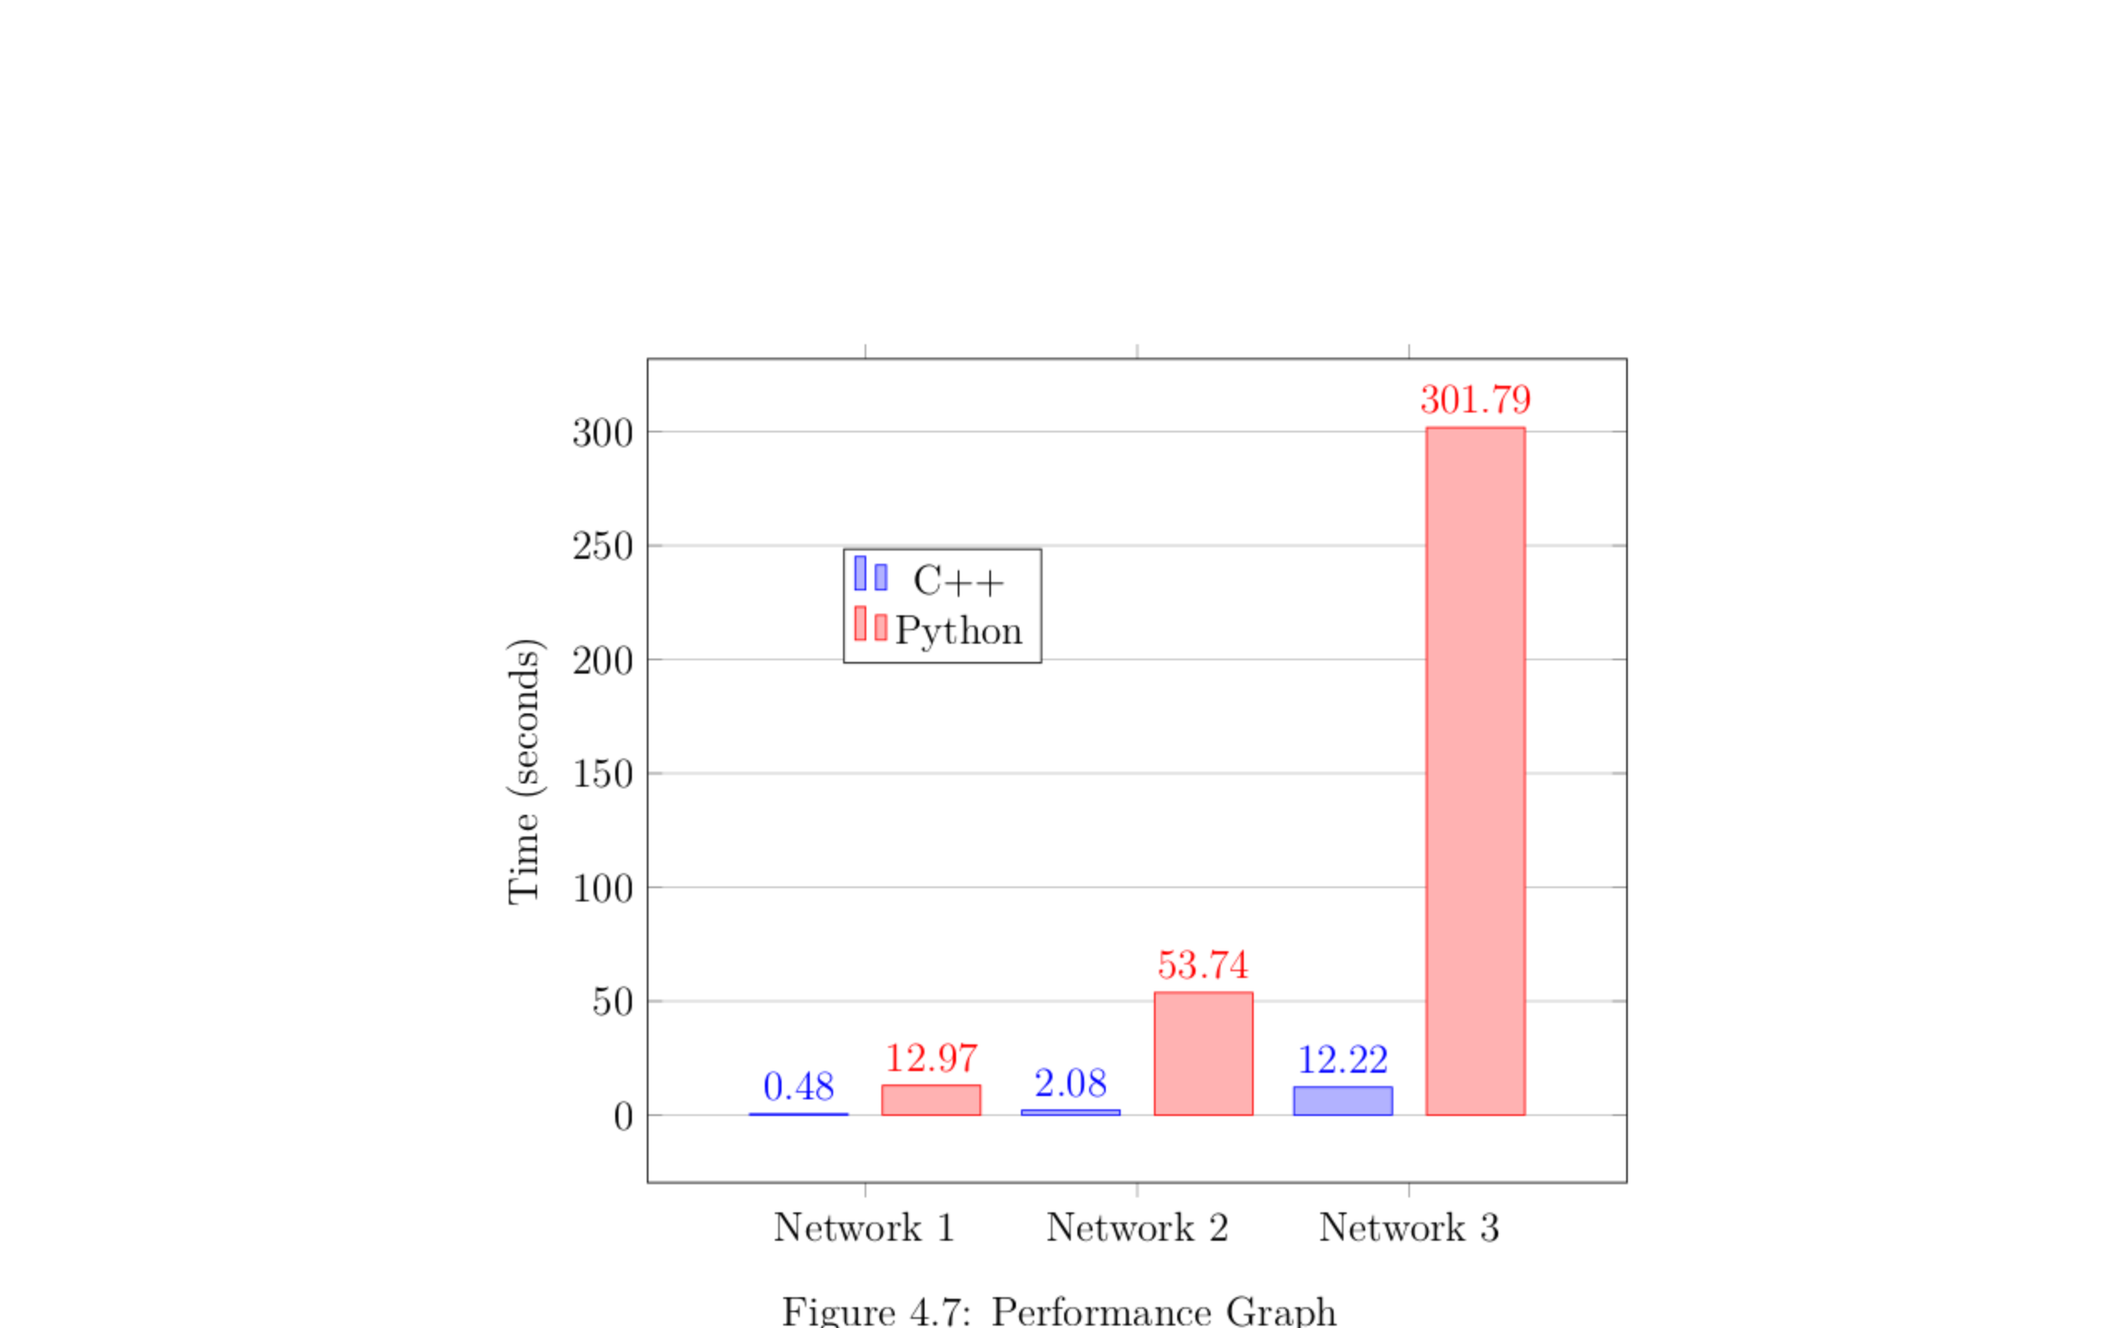
Supplemental Slides

