Slide 1

Application-Level Checkpoint/Restart for
Large-Scale Attack and Compliance Graphs
IEEE SoutheastCon 2024 - Atlanta, GA
“Engineering the Future”
Noah L. Schrick, Peter J. Hawrylak
University of Tulsa
Track#3
Session:
Presentation Date

Slide 2
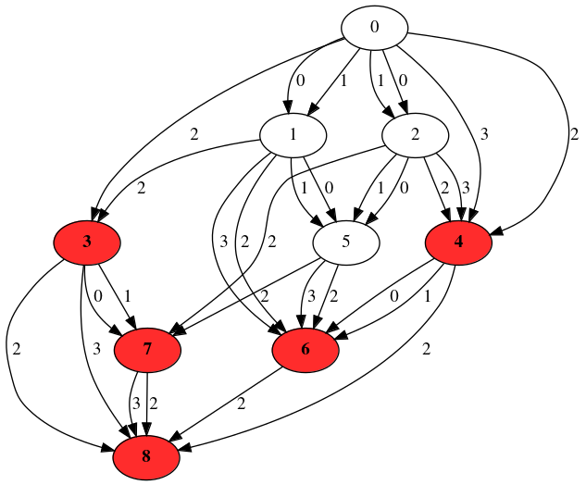
Introduction (1/2)
Overview
Attack Graph -
    Determine all possible ways systems may be compromised [1]
Compliance Graph -
    Determine all possible ways systems may fall out of compliance [2]
IEEE SoutheastCon 2024 - Atlanta, GA

Slide 3
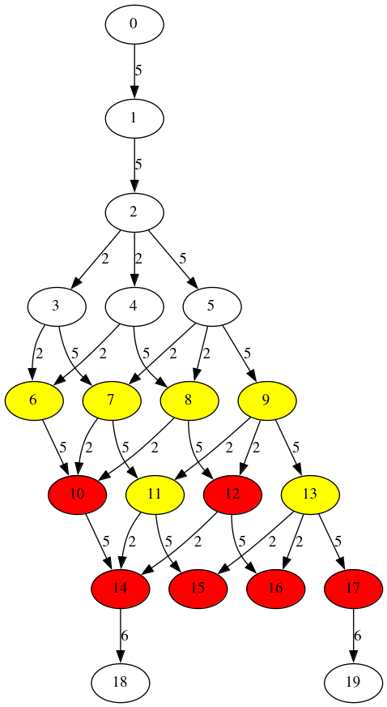
Introduction (2/2)
Terminology/Descriptions
Nodes
    States within the graph.
    Have system information embedded within the object.
        Example: Windows 10 machine, pfSense firewall vX.Y, 2006 Toyota Corolla
Edges
    Transitions within the graph.
    Events that lead to a change in the system(s) or environment(s).
        Example: Installing or updating software/hardware, regularly occurring maintenance, spread of malware
IEEE SoutheastCon 2024 - Atlanta, GA

Slide 4
Challenges (1/2)
Challenges with Attack and Compliance Graphs
Scalability (State Space Explosion) [3, 7]
    The exponential growth of states and edges caused through minimal additions of assets, qualities, or events .
    Leads to graphs with hundreds of millions of nodes, and billions of edges.
High Runtime Requirements [3-7]
    Real-world performance of graph operations does not align with the theoretical assumption.
    Scalability – large graphs take exceedingly long to generate.
        Example: Installing or updating software/hardware, regularly occurring maintenance, spread of malware
IEEE SoutheastCon 2024 - Atlanta, GA

Slide 5
Challenges (2/2)
Implications
Graphs and graph operations cannot be contained within non-volatile memory (RAM).
    Out-of-memory killers will terminate the generation process.
Outages, HPC cycle exhaustion, or other interruption forces a complete re-generation of the graphs.
    Can result in a loss of weeks’ worth of processing.
IEEE SoutheastCon 2024 - Atlanta, GA

Slide 6
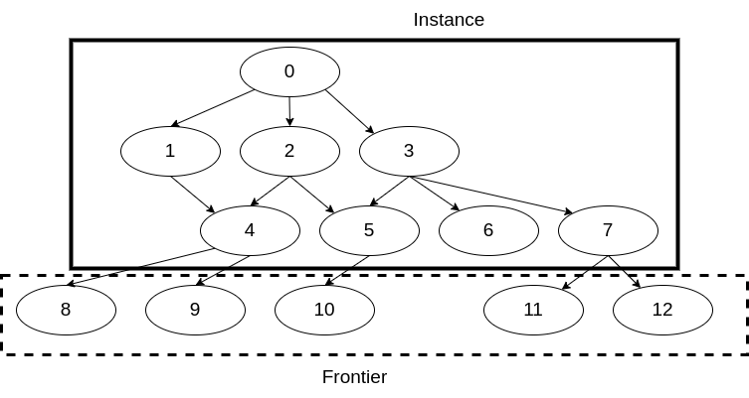
Memory Constraint
Two Primary Pain Points
The queue of unexplored nodes
      “Frontier”
      Caused by the Breadth-First Search generation approach
The graph object
      “Instance”
      All explored nodes (and their embedded information), edges, flags, or auxiliary graph labels or features
IEEE SoutheastCon 2024 - Atlanta, GA

Slide 7
Related Works
Specific to Attack and Compliance Graphs
Efficient storage techniques [13, 14].
Logic-based generation [15].
Alternate information representation schemes [16, 17].
Sampling [18].
Parallelization [19].
IEEE SoutheastCon 2024 - Atlanta, GA

Slide 8
Checkpoint/Restart (C/R)
Introduction
A technique that saves the state of a program mid-execution, and allows for a restart from a saved state.
Three categories [8, 9]:
    System-level
        Requires compatibility with the operating system, and any application libraries (e.g., MPI).
        Large in scope: can restore process IDs, checkpoint shell scripts, sockets, threads, file processing.
    User-level
        Large, application-independent checkpoints that are linked through libraries.
    Application-level
        Built into an application’s source code.
        Goal: only handle the necessary information.
IEEE SoutheastCon 2024 - Atlanta, GA

Slide 9
Goal of This Work
Implement Application-level C/R
Minimal checkpoints for fast, efficient checkpoint and restart procedures.
    C/R will also be portable, and independent of external libraries or operating systems.
Benefits are twofold:
    Provides a form of fault-tolerance in the event of interruption.
    Provides a means of memory relief by dumping excess, no longer relevant graph instances during checkpoint intervals.
IEEE SoutheastCon 2024 - Atlanta, GA

Slide 10
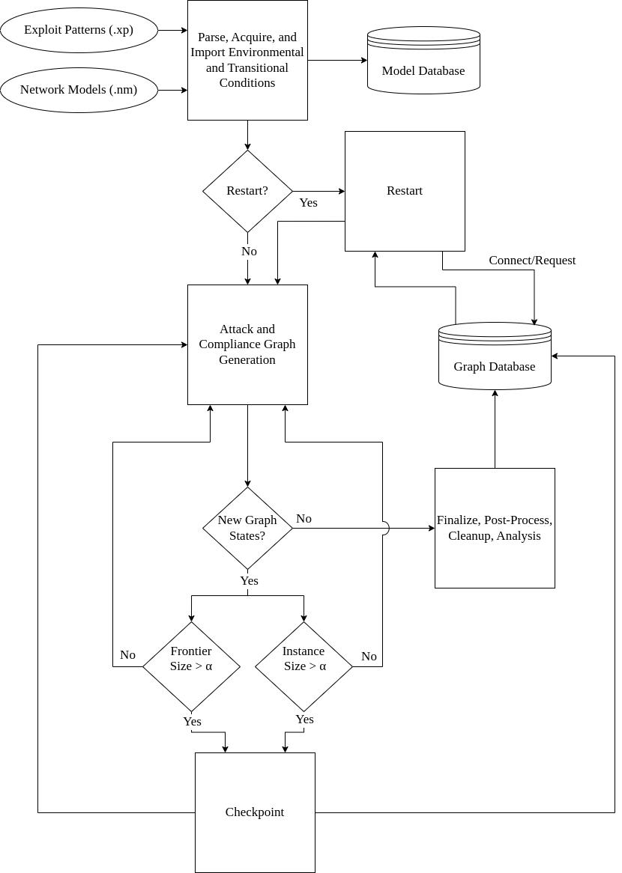
Overview
Generation Process
IEEE SoutheastCon 2024 - Atlanta, GA

Slide 11
Checkpointing
Implementation Details
Dynamic storing
    Based on available memory.
    New PostgreSQL table for the frontier.
        Graph instance tables already existed.
        Maintain proper ordering of FIFO queue.
Alpha (⍺) Parameter
    (0, 1.0)
        Checkpoint when a graph instance consumes a percentage of memory relative to allocated.
    [1.0, n)
        Checkpoint when the graph instance has n nodes.
    Ideally, user will pass in memory requests to a job scheduler (e.g., Slurm), and RAGE.
IEEE SoutheastCon 2024 - Atlanta, GA

Slide 12
Checkpointing
Implementation Details
Processed during the OpenMP critical section, but can be passed to the dedicated MPI database node to allow for a continuation in generation.
Memory buffer is reserved for building SQL queries.
No file system dependencies required.
Abstracted from PostgreSQL specific implementations, so PostgreSQL redundancies can be added to the cluster with no cost to application runtime.
IEEE SoutheastCon 2024 - Atlanta, GA

Slide 13
Restarting
Implementation Details
New restart parameter.
Pulls the frontier.
Recovers node ID positioning.
Graph instance was already explored: no need to recover the known instance.
IEEE SoutheastCon 2024 - Atlanta, GA

Slide 14
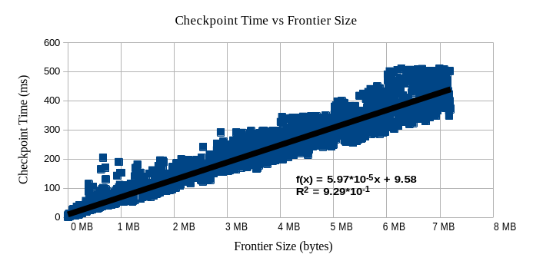
Results - Checkpointing
Linear relationship between checkpoint time and frontier size.
IEEE SoutheastCon 2024 - Atlanta, GA

Slide 15
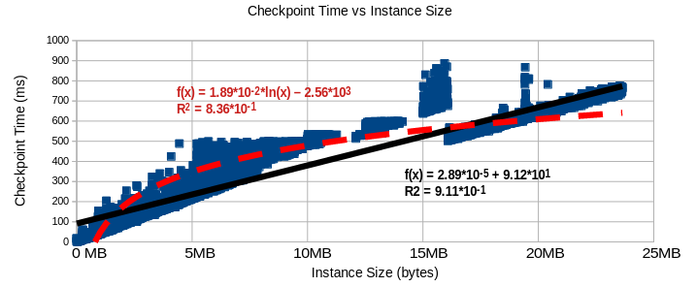
Results - Checkpointing
Bound by a logarithmic relationship between checkpoint time and instance size when the instance is smaller.
As the instance grows, checkpoint time better fits to a linear relationship.
IEEE SoutheastCon 2024 - Atlanta, GA

Slide 16
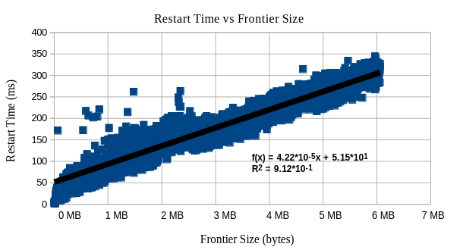
Results - Restarting
Linear relationship between restart time and frontier size.
IEEE SoutheastCon 2024 - Atlanta, GA

Slide 17
Conclusions
Implemented Application-level CR that:
Successfully alleviates “unnecessary” memory pressure for large graphs.
Minimally checkpoints graph objects and an unexplored queue of nodes without consuming an excessive amount of runtime.
Restarts to a known state in the event of an interruption without consuming an excessive amount of runtime.
IEEE SoutheastCon 2024 - Atlanta, GA

Slide 18
Future Work
Should Investigate:
Comparison to known C/R libraries:
    Scalable Checkpoint/Restart (SCR) [10].
    Distributed MultiThreaded Checkpointing (DMTCP) [11].
    Berkely Lab Checkpoint/Restart [12].
Optimize database queries and/or database configurations.
Filesystem C/R.
Optimizing checkpointing interval [21].
IEEE SoutheastCon 2024 - Atlanta, GA

Slide 19
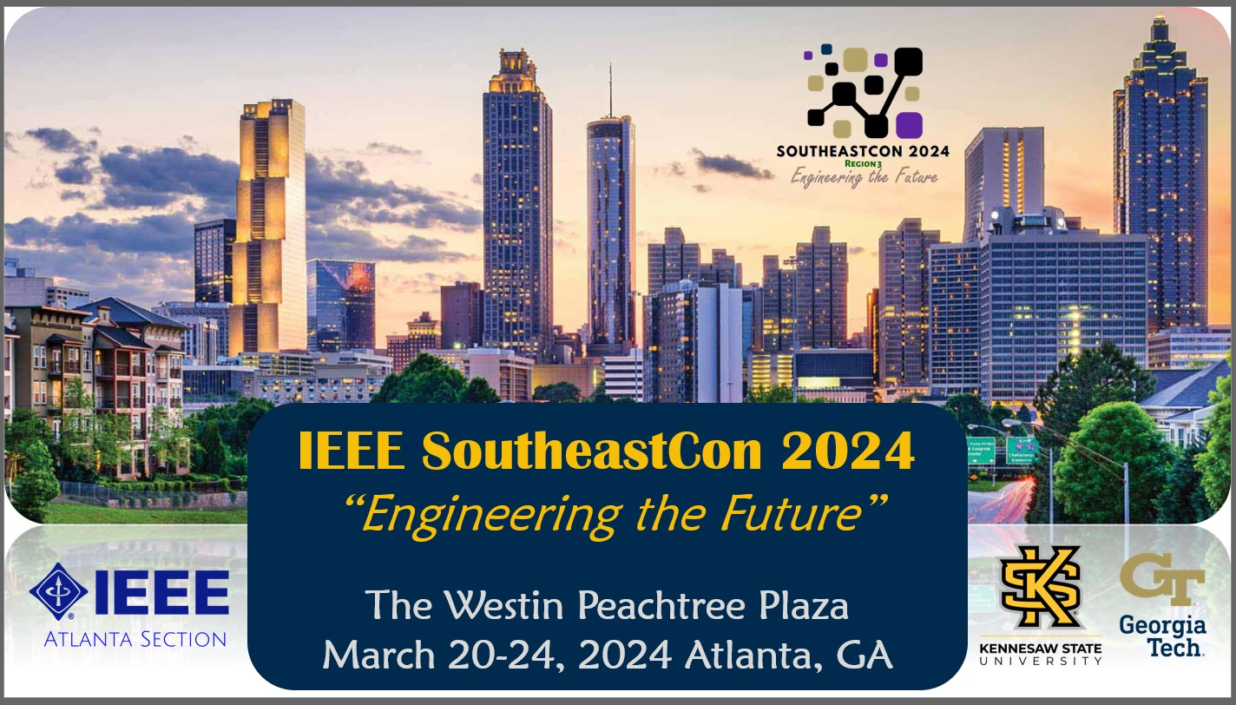
Thank You!

