Slide 1

Application-Level Checkpoint/Restart for
Large-Scale Attack and Compliance Graphs
IEEE SoutheastCon 2024 - Atlanta, GA
“Engineering the Future”
Noah L. Schrick, Peter J. Hawrylak
University of Tulsa
Track#3
Session:
Presentation Date

Slide 2
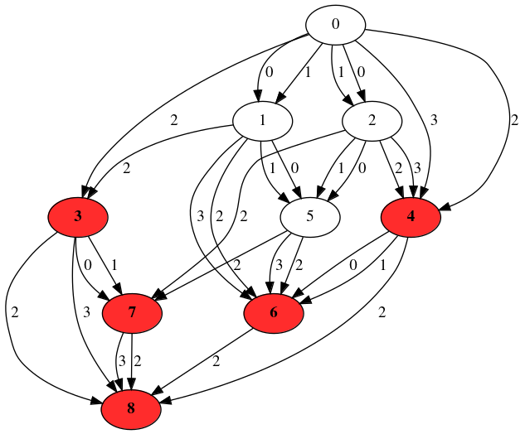
Introduction (1/2)
Overview
Attack Graph -
    Determine all possible ways systems may be compromised [1]
Compliance Graph -
    Determine all possible ways systems may fall out of compliance [2]
IEEE SoutheastCon 2024 - Atlanta, GA

Slide 3
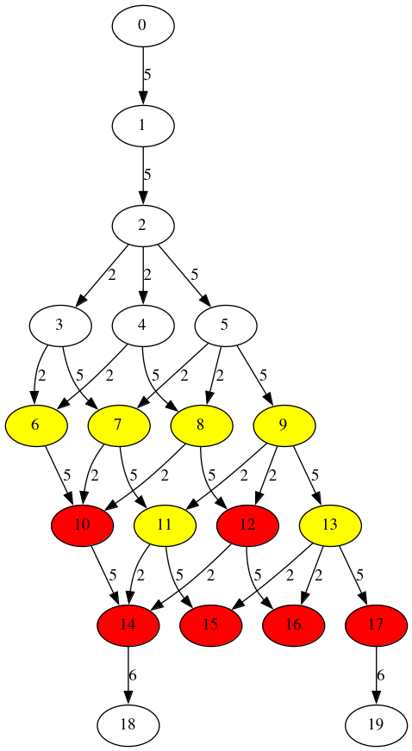
Introduction (2/2)
Terminology/Descriptions
Nodes
    States within the graph.
    Have system information embedded within the object.
        Example: Windows 10 machine, pfSense firewall, 2006 Toyota Corolla
Edges
    Transitions within the graph.
    Events that lead to a change in the system(s) or environment(s).
        Example: Installing or updating software/hardware, regularly occurring maintenance, spread of malware
IEEE SoutheastCon 2024 - Atlanta, GA

Slide 4
Challenges (1/2)
Challenges with Attack and Compliance Graphs
Scalability (State Space Explosion) [3, 7]
    The exponential growth of states and edges caused through minimal additions of assets, qualities, or events .
    Leads to graphs with hundreds of millions of nodes, and billions of edges.
High Runtime Requirements [3-7]
    Real-world performance of graph operations does not align with the theoretical assumption.
    Scalability – large graphs take exceedingly long to generate.
        Example: Installing or updating software/hardware, regularly occurring maintenance, spread of malware
IEEE SoutheastCon 2024 - Atlanta, GA

Slide 5
Challenges (2/2)
Implications
Graphs and graph operations cannot be contained within non-volatile memory (RAM).
    Out-of-memory killers will terminate the generation process.
Outages, HPC cycle exhaustion, or other interruption forces a complete re-generation of the graphs.
    Can result in a loss of weeks’ worth of processing.
IEEE SoutheastCon 2024 - Atlanta, GA

Slide 6
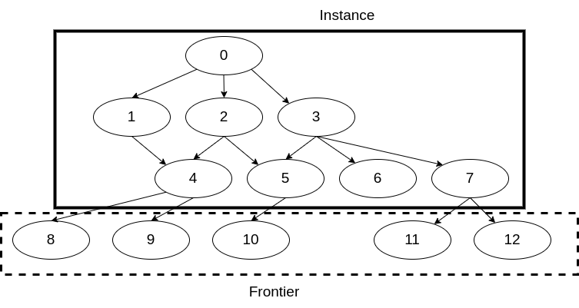
Memory Constraint
Two Primary Pain Points
The queue of unexplored nodes
      “Frontier”
      Caused by the Breadth-First Search generation approach
The graph object
      “Instance”
      All explored nodes (and their embedded information), edges, flags, or auxiliary graph labels or features
IEEE SoutheastCon 2024 - Atlanta, GA

Slide 7
Related Works
Specific to Attack and Compliance Graphs
Efficient storage techniques [13, 14].
Logic-based generation [15].
Alternate information representation schemes [16, 17].
Sampling [18].
Parallelization [19].
IEEE SoutheastCon 2024 - Atlanta, GA

Slide 8
Checkpoint/Restart (C/R)
Introduction
A technique that saves the state of a program mid-execution, and allows for a restart from a saved state.
Three categories [8, 9]:
    System-level
        Requires compatibility with the operating system, and any application libraries (e.g., MPI).
        Large in scope: can restore process IDs, checkpoint shell scripts, sockets, threads, file processing.
    User-level
        Large, application-independent checkpoints that are linked through libraries.
    Application-level
        Built into an application’s source code.
        Goal: only handle the necessary information.
IEEE SoutheastCon 2024 - Atlanta, GA

Slide 9
Goal of This Work
Implement Application-level C/R
Minimal checkpoints for fast, efficient checkpoint and restart procedures.
    C/R will also be portable, and independent of external libraries or operating systems.
Benefits are twofold:
    Provides a form of fault-tolerance in the event of interruption.
    Provides a means of memory relief by dumping excess, no longer relevant graph instances during checkpoint intervals.
IEEE SoutheastCon 2024 - Atlanta, GA

Slide 10
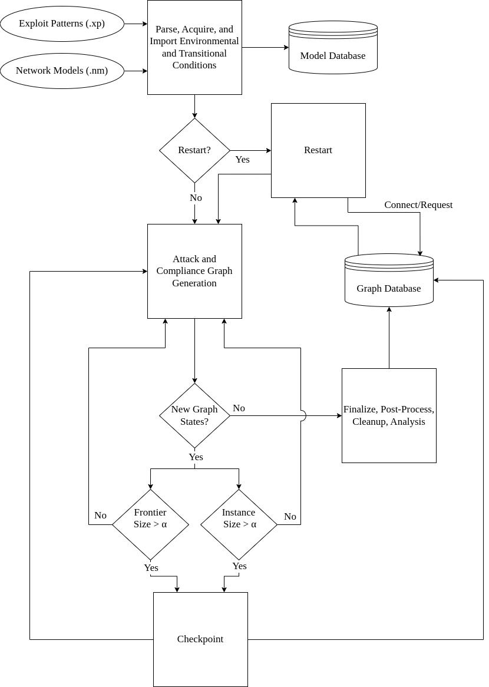
Overview
Generation Process
Details…
IEEE SoutheastCon 2024 - Atlanta, GA

Slide 11
Checkpointing
Description
Details…
IEEE SoutheastCon 2024 - Atlanta, GA

Slide 12
Restarting
Description
Details…
IEEE SoutheastCon 2024 - Atlanta, GA

Slide 13
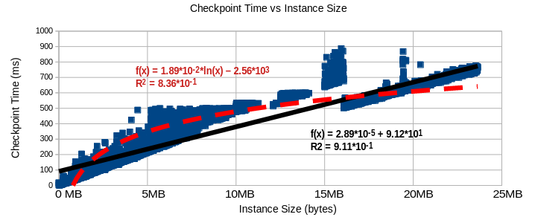
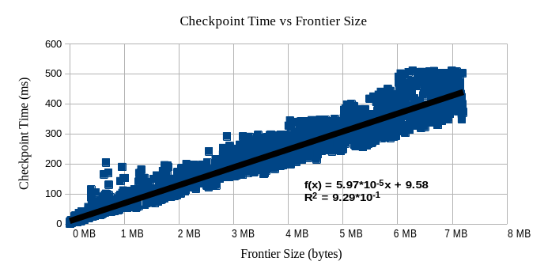
Results - Checkpointing
Description
Details…
IEEE SoutheastCon 2024 - Atlanta, GA

Slide 14
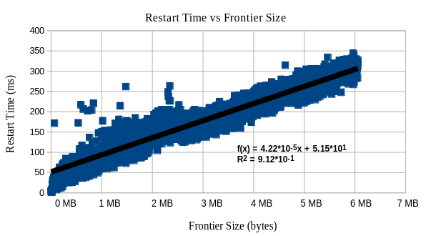
Results - Restarting
Description
Details…
IEEE SoutheastCon 2024 - Atlanta, GA

Slide 15
Conclusions
Description
Details…
IEEE SoutheastCon 2024 - Atlanta, GA

Slide 16
Future Work
Description
Details…
IEEE SoutheastCon 2024 - Atlanta, GA

Slide 17
References
Description
Details…
IEEE SoutheastCon 2024 - Atlanta, GA

Slide 18
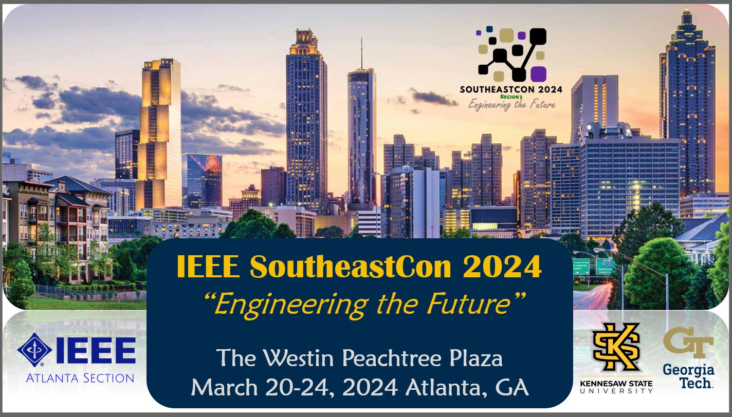
Thank You!

